Slide 1
Austin-East
Magnet High School
Austin-East
Magnet High School
2023-2024

Slide 2
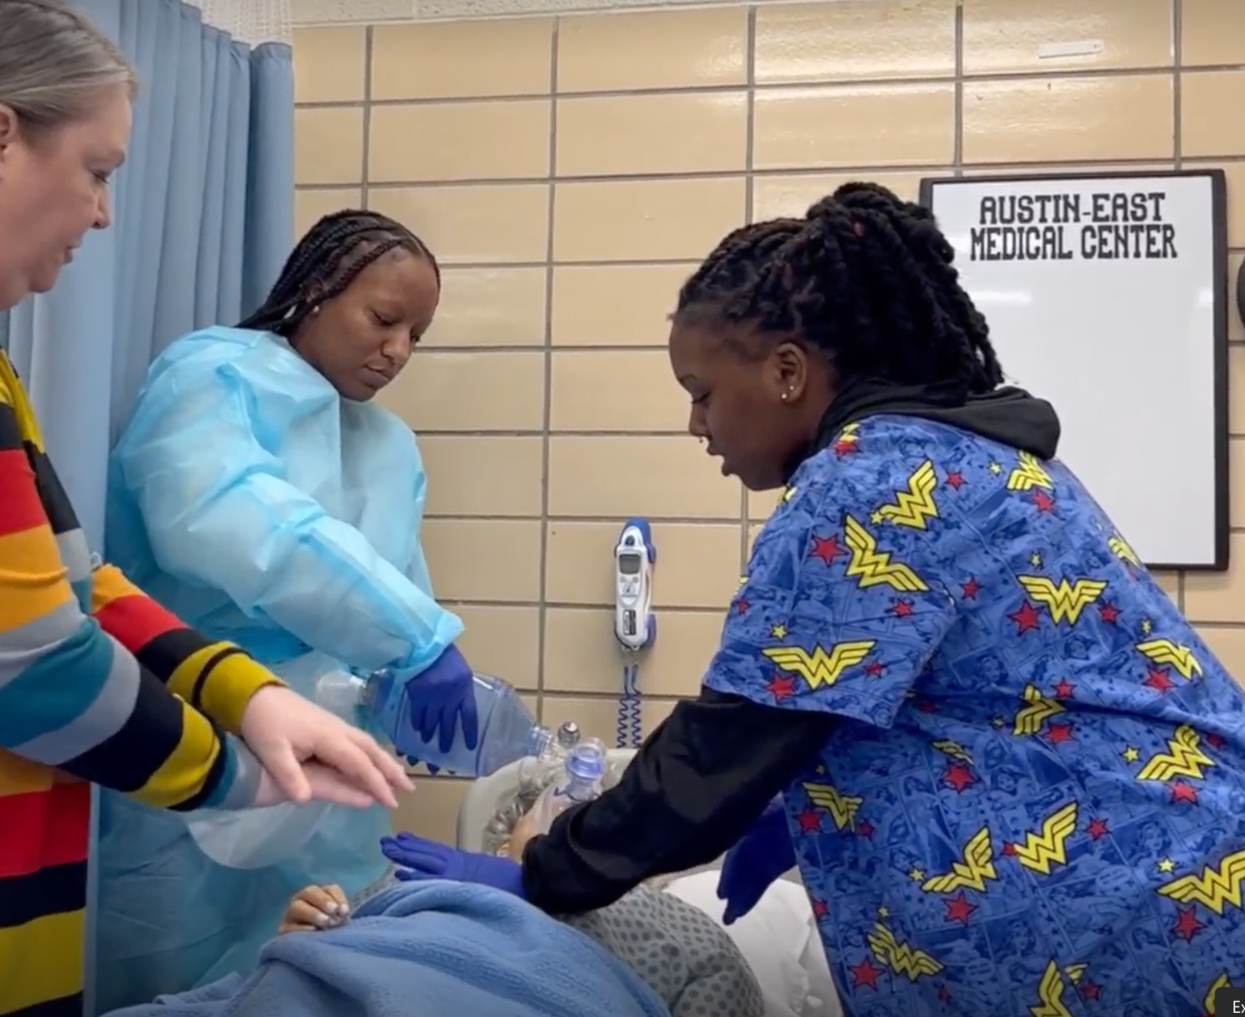
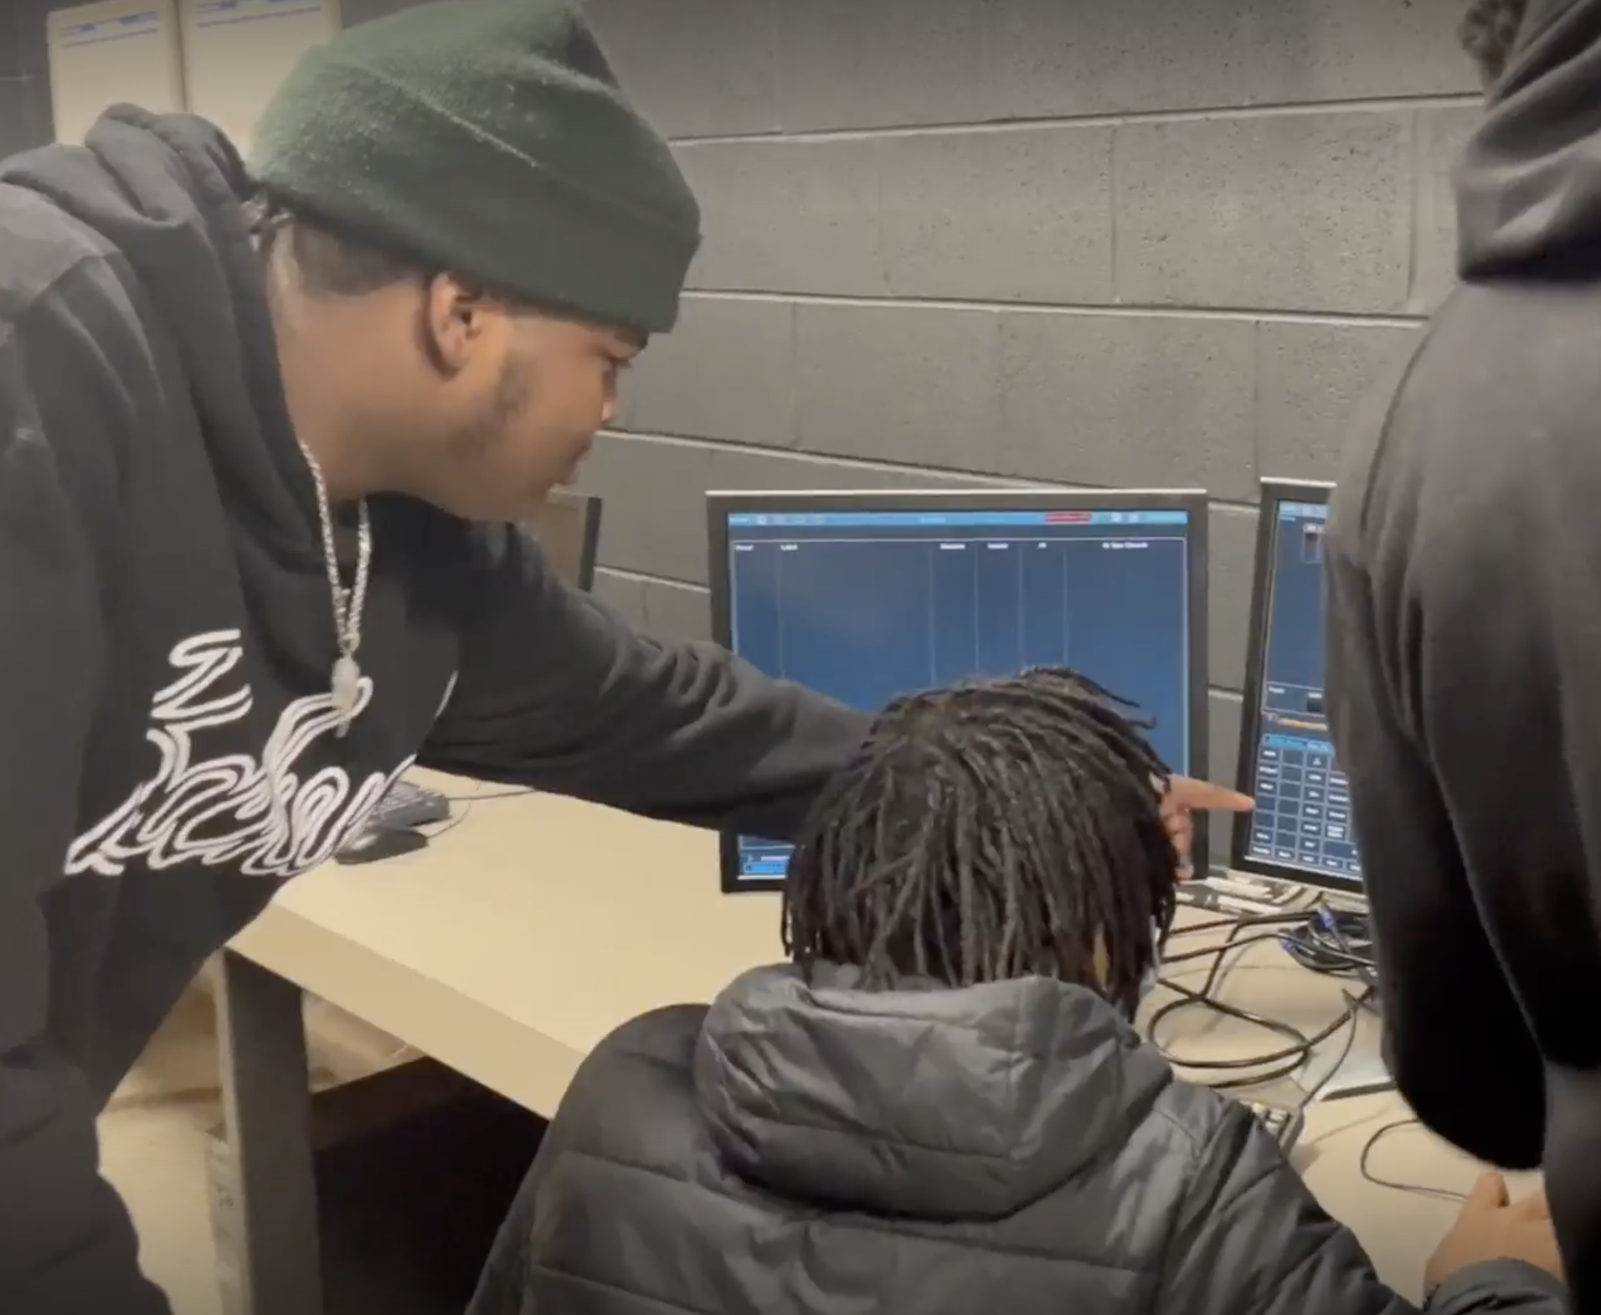
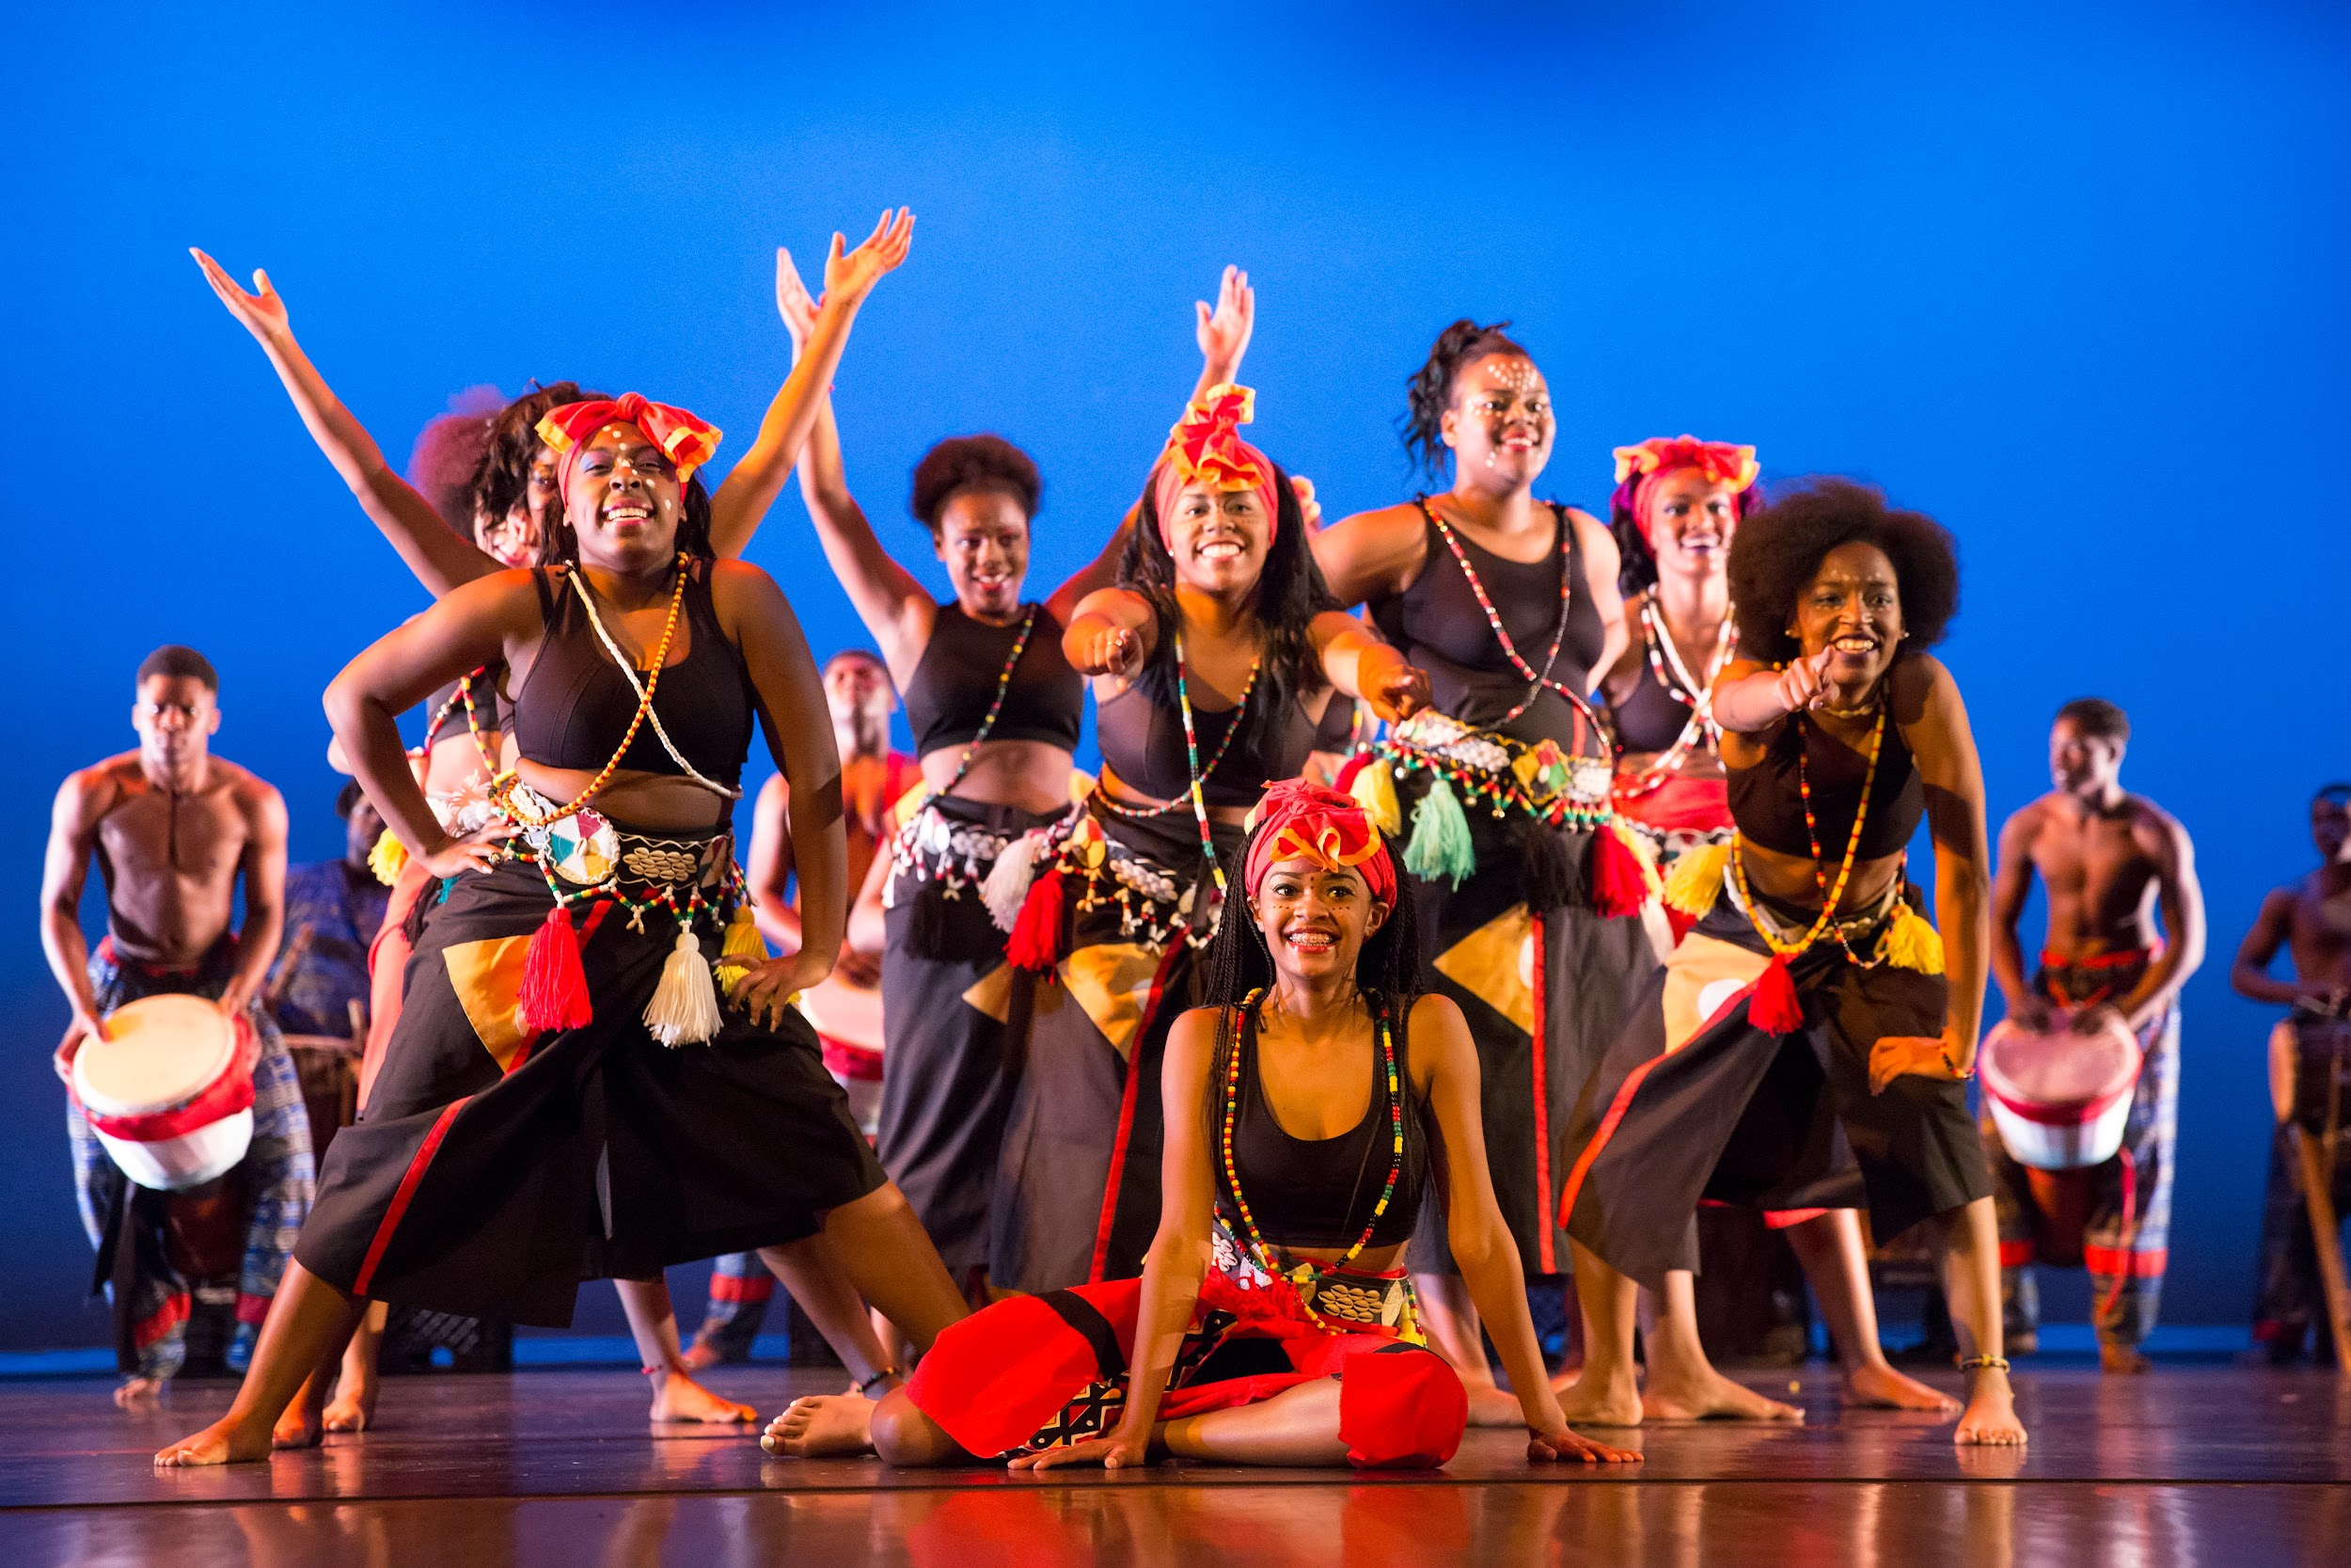
Austin-East Magnet High School
Location: 2800 Martin Luther King Jr. Ave, 37914
Magnet Programming: Performing Arts
Hours: 8:30-3:45 (early release every Wednesday)
Population: 679 Students, 67 Teachers
Our Mission Statement: At Austin-East, we will educate, equip, and empower our students to achieve academically, thrive socially, dream limitlessly, and serve their community with purpose and pride.

Slide 3
Academies at Austin-East

Slide 4
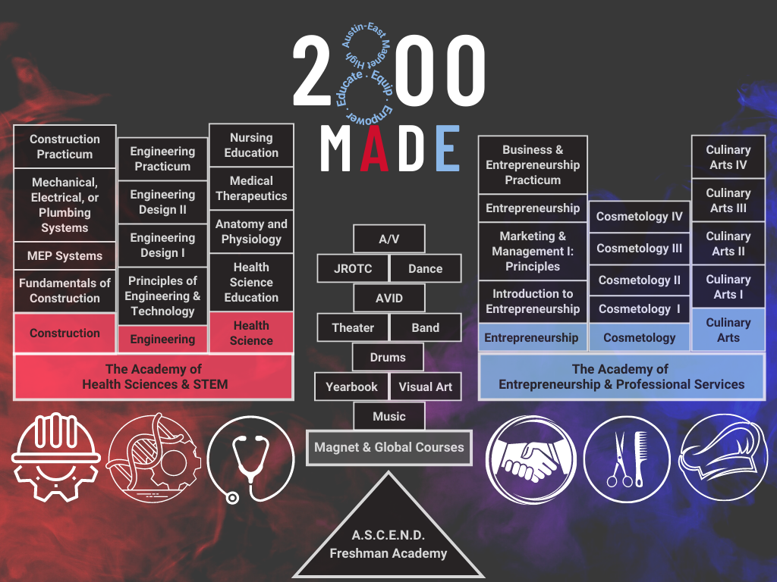

Slide 5
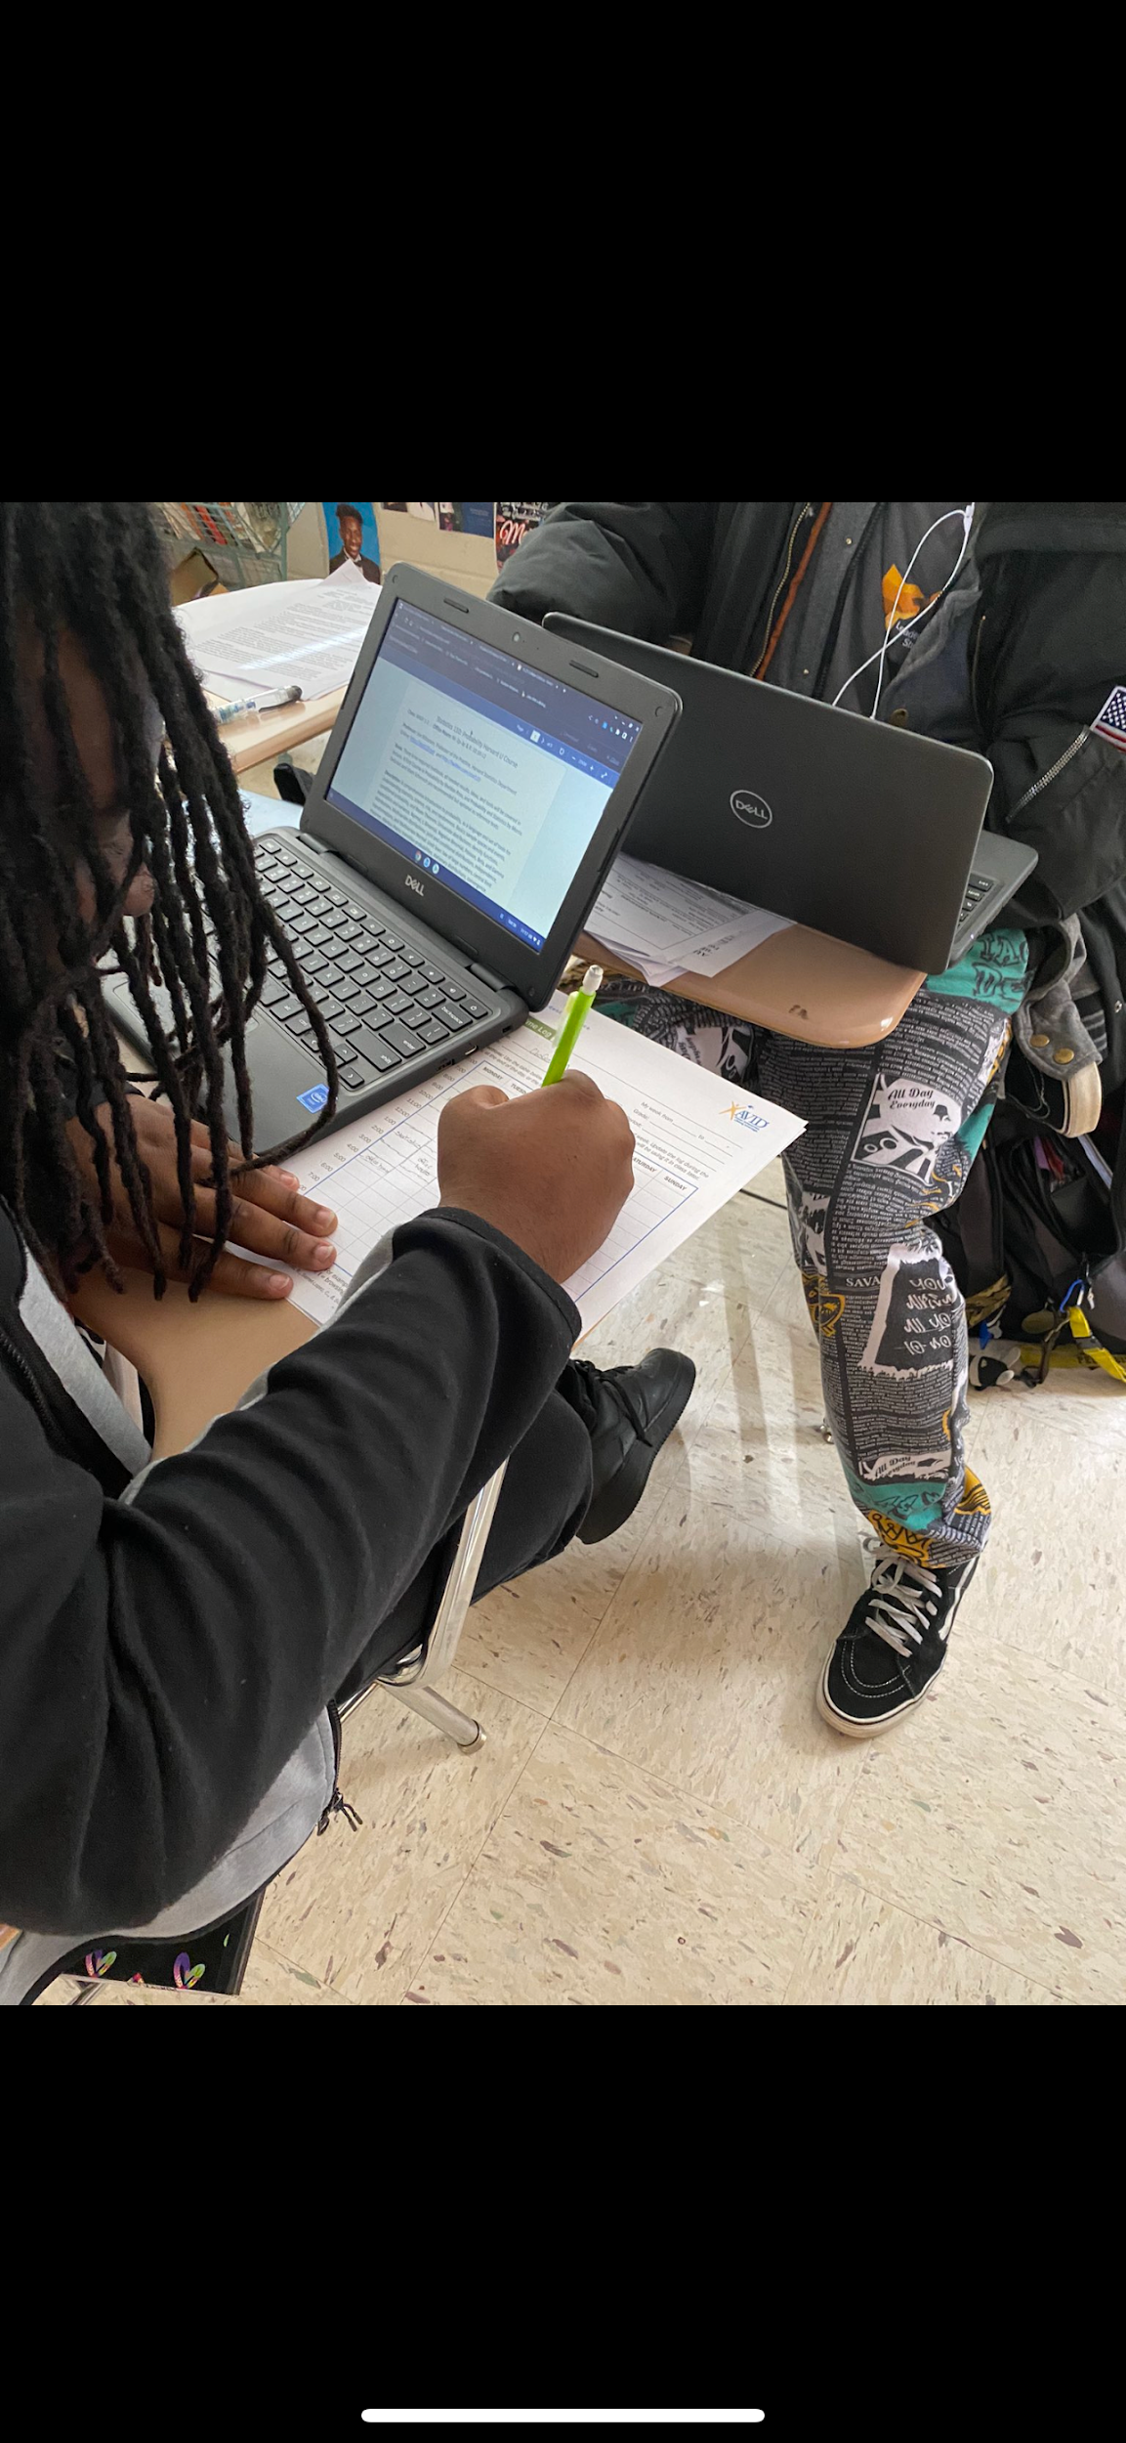
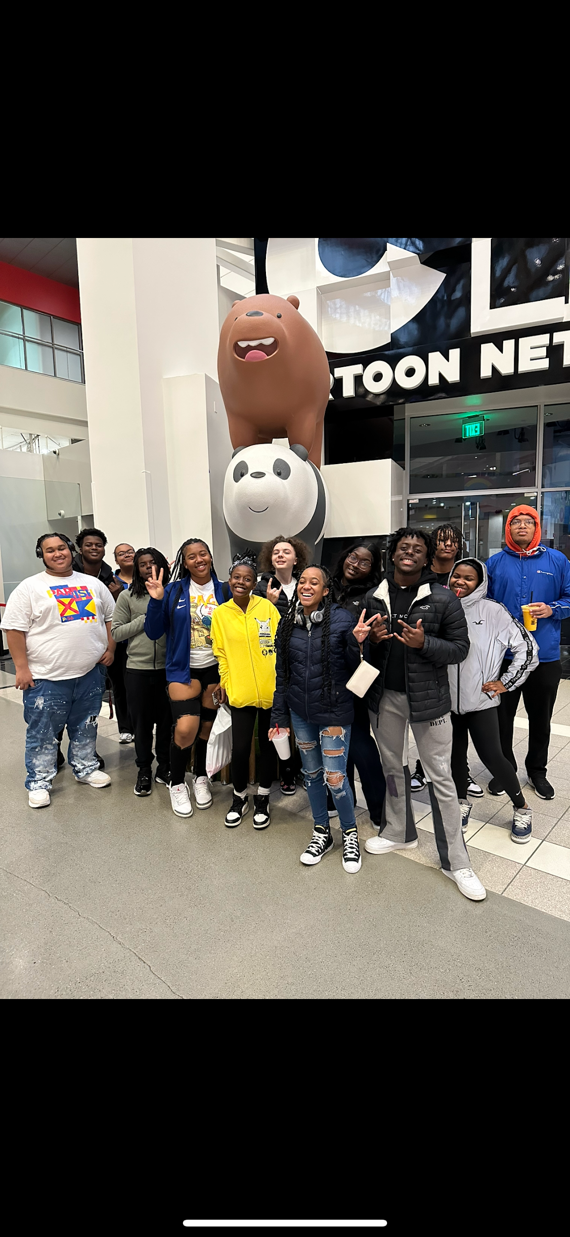
AVID
AVID (Advancement Via Individual Determination) is an elective offered to all grade levels and focuses on college and career readiness. AVID’s mission is to close the achievement, expectation, and opportunity gap many students face, and it prepares all students for success in a global society.
AVID focuses on writing, inquiry, collaboration, organization, and reading while also giving students a sense of community. We call it our “AVID family”!

Slide 6
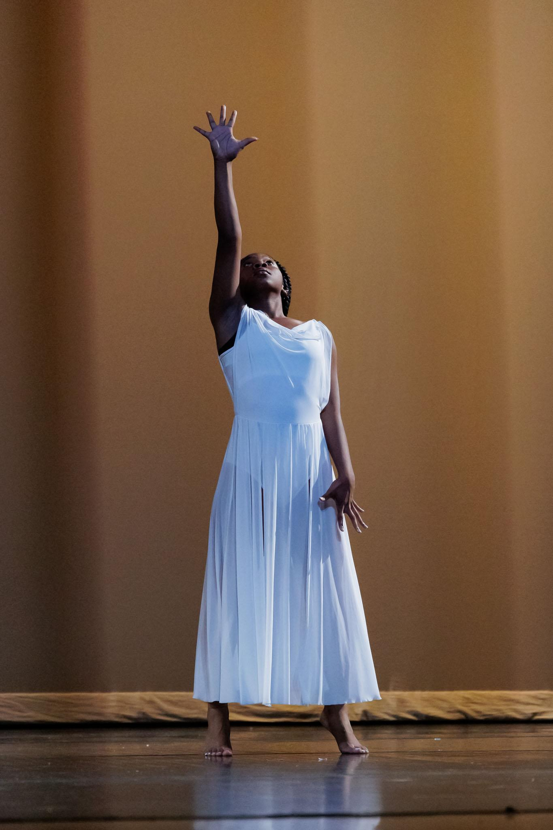
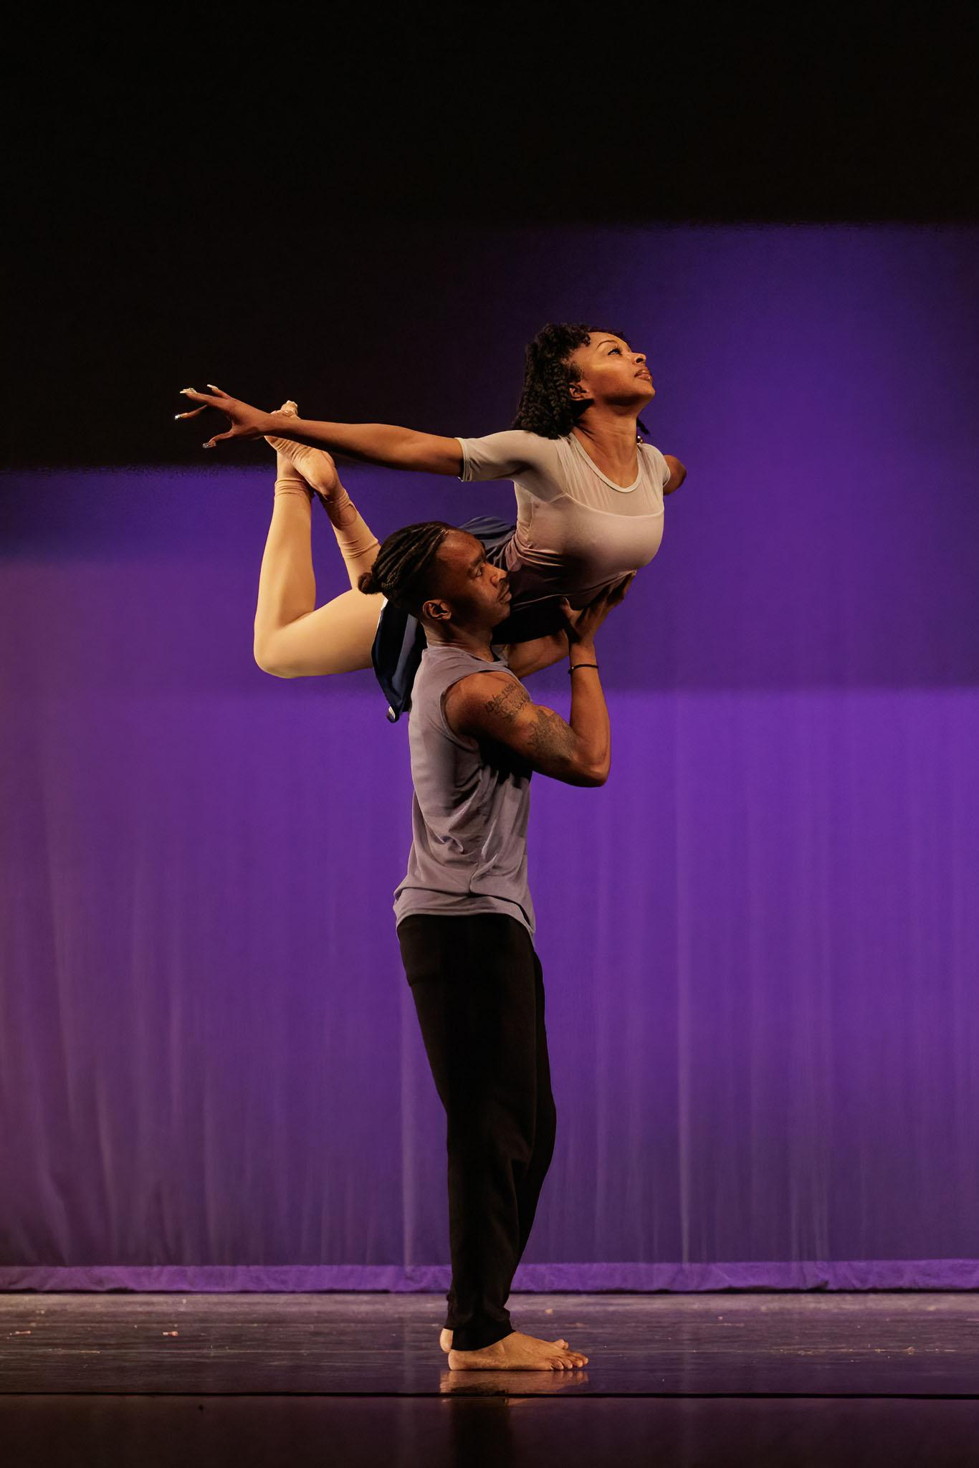
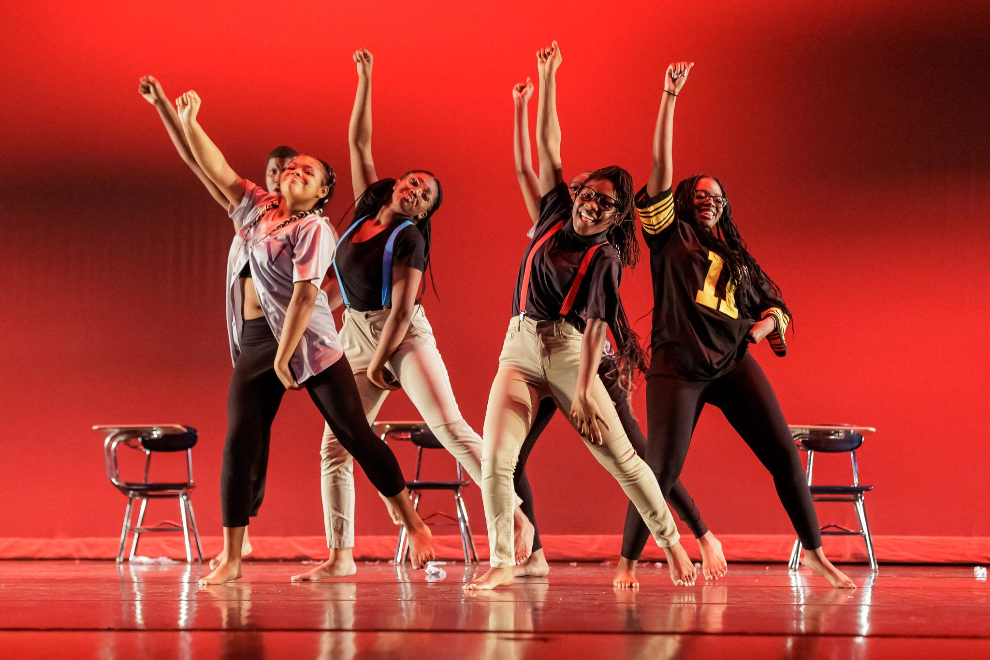
Austin-East Dance Company

Slide 7
Austin-East Dance Company
Austin-East Dance Company is an audition only class comprised of dancers in 9th through 12th grade. AEDC studies Ballet, Jazz, Modern, Contemporary, Hip hop and West African dance. Each year AEDC hosts VOICES, a showcase of student choreography as well as the Spring Dance Showcase which features Beaumont, Vine, and Austin-East. Austin-East Dance Company has a long standing history of strong dancers that have continued their dance training post secondary as well as onto the professional stage.

Slide 8
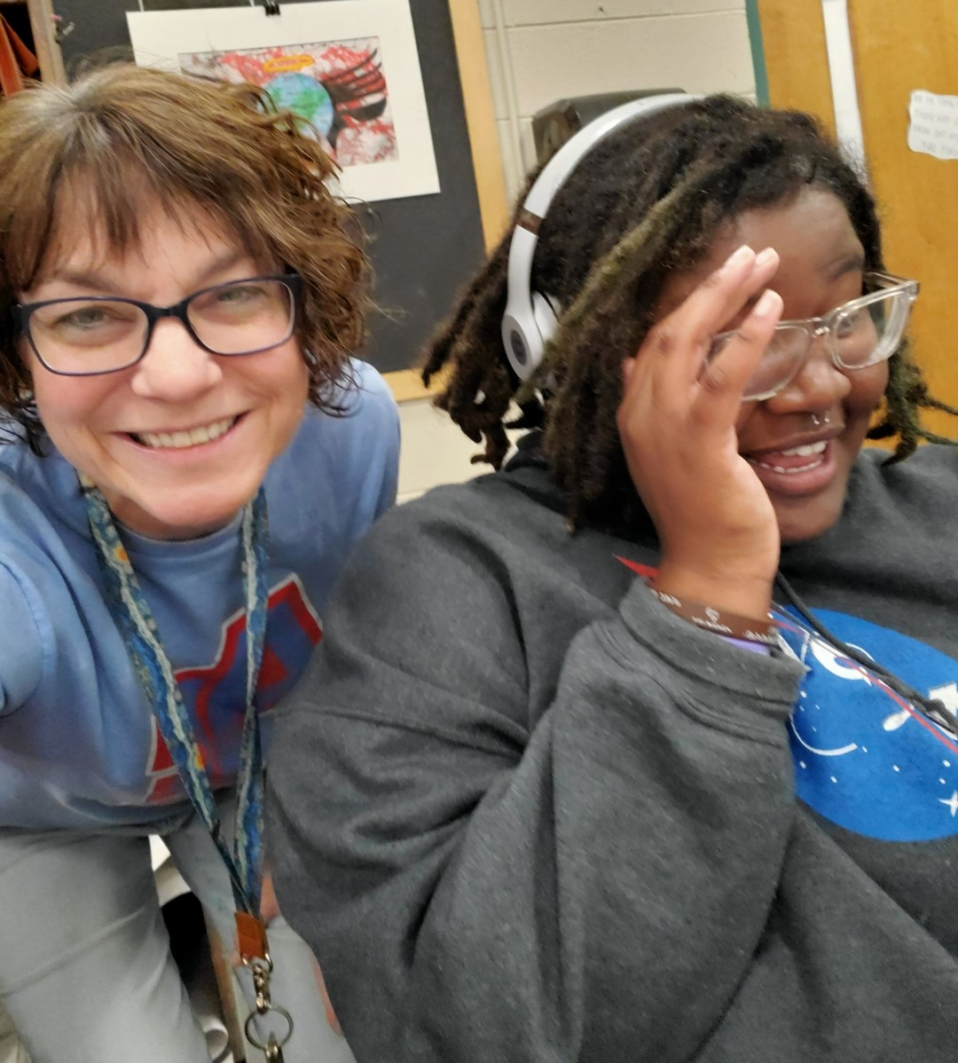
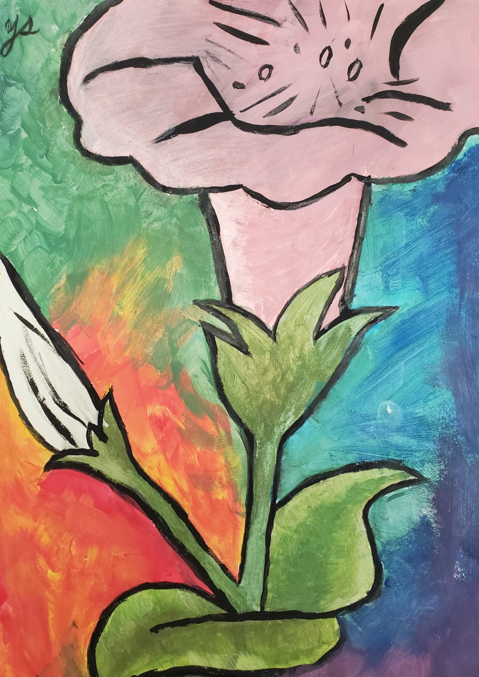
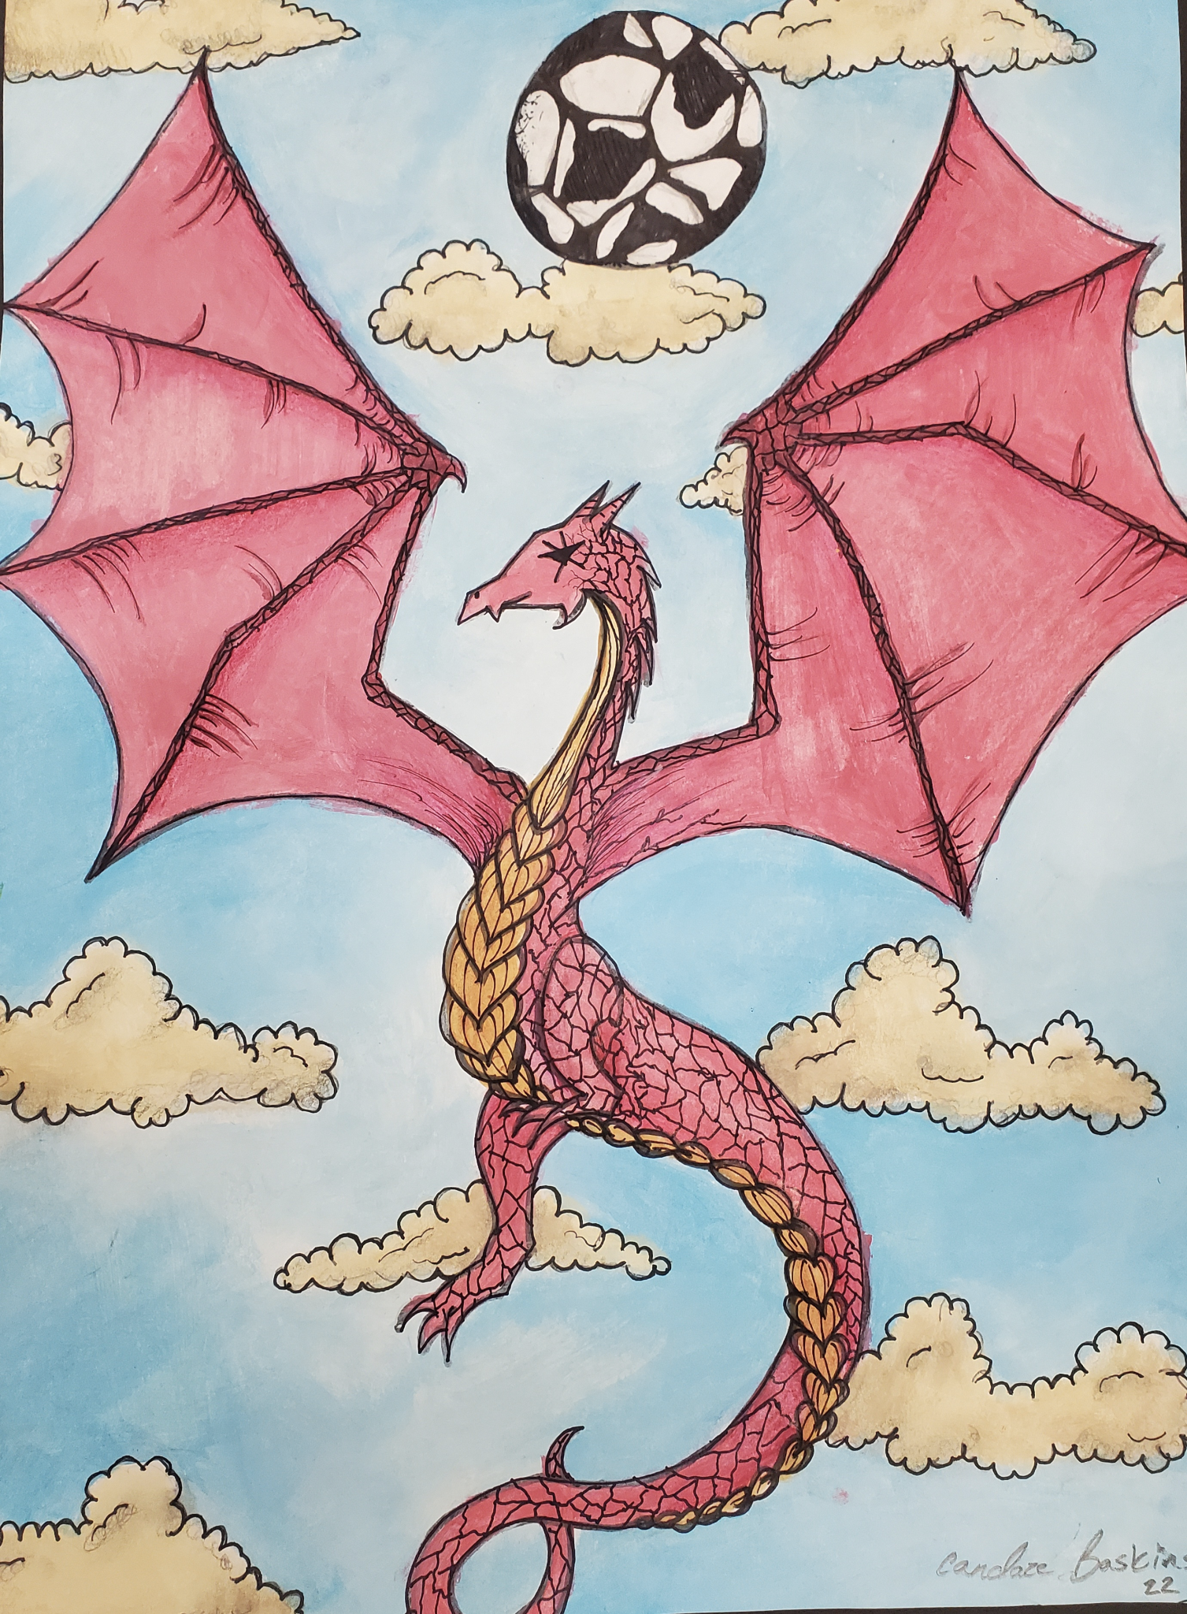
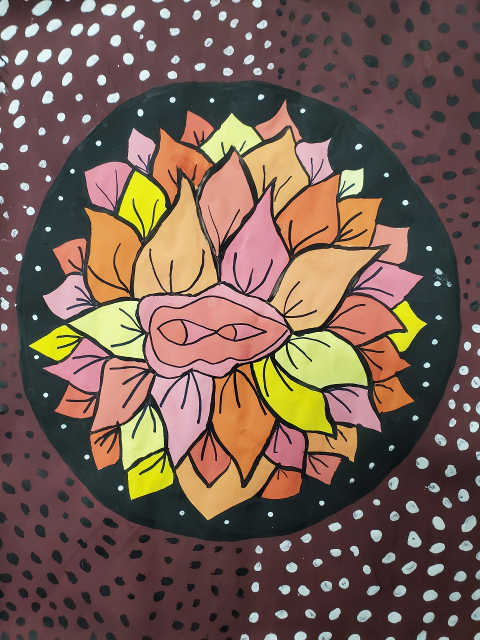
Visual Arts
Be creative EVERY DAY in the art room with Ms. Adams!
Think you can’t make beautiful, meaningful art? Look at what your classmates have created!

Slide 9
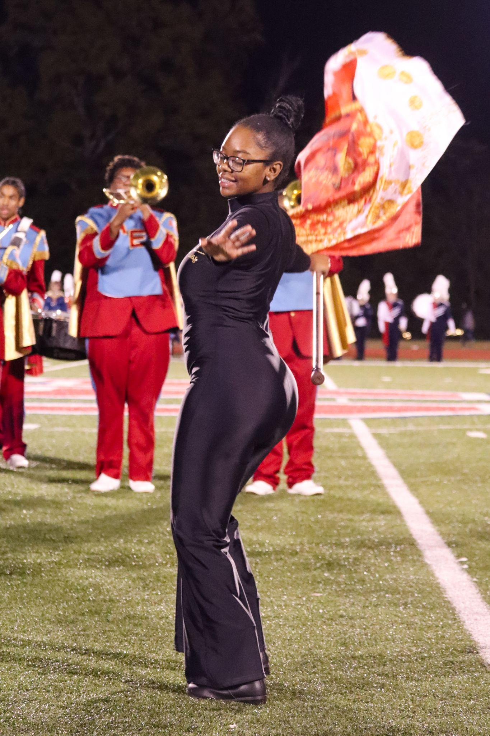
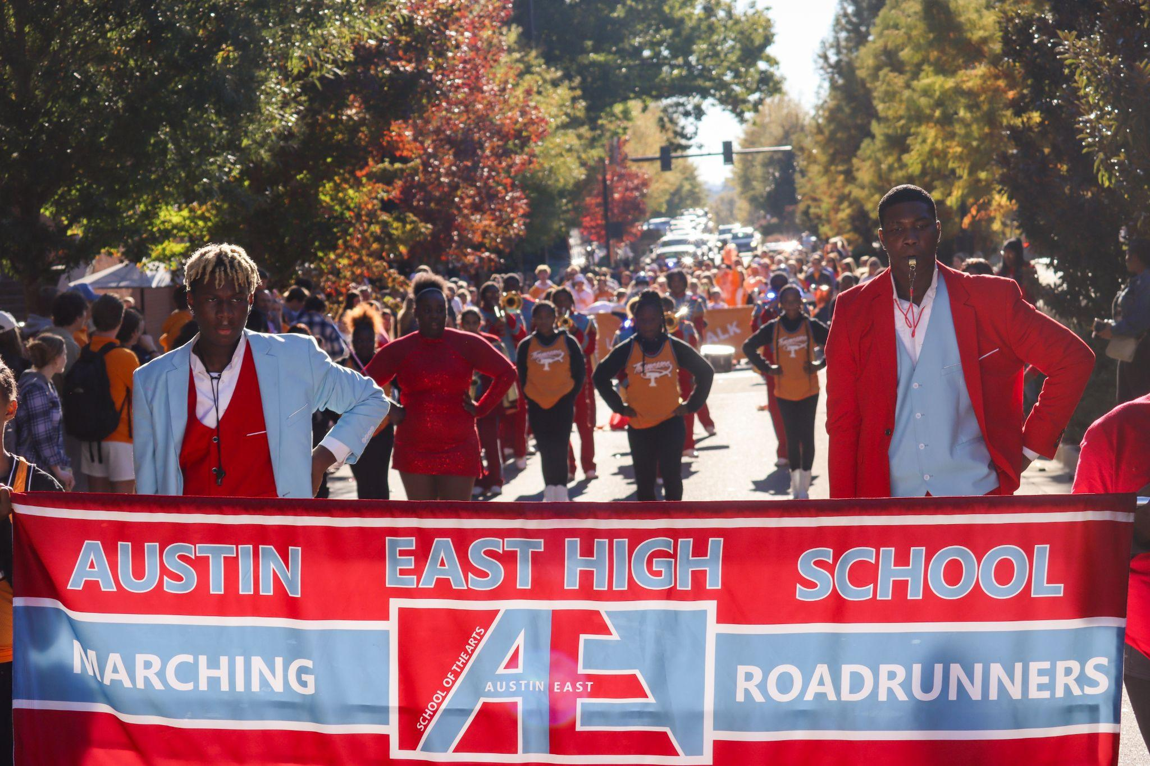
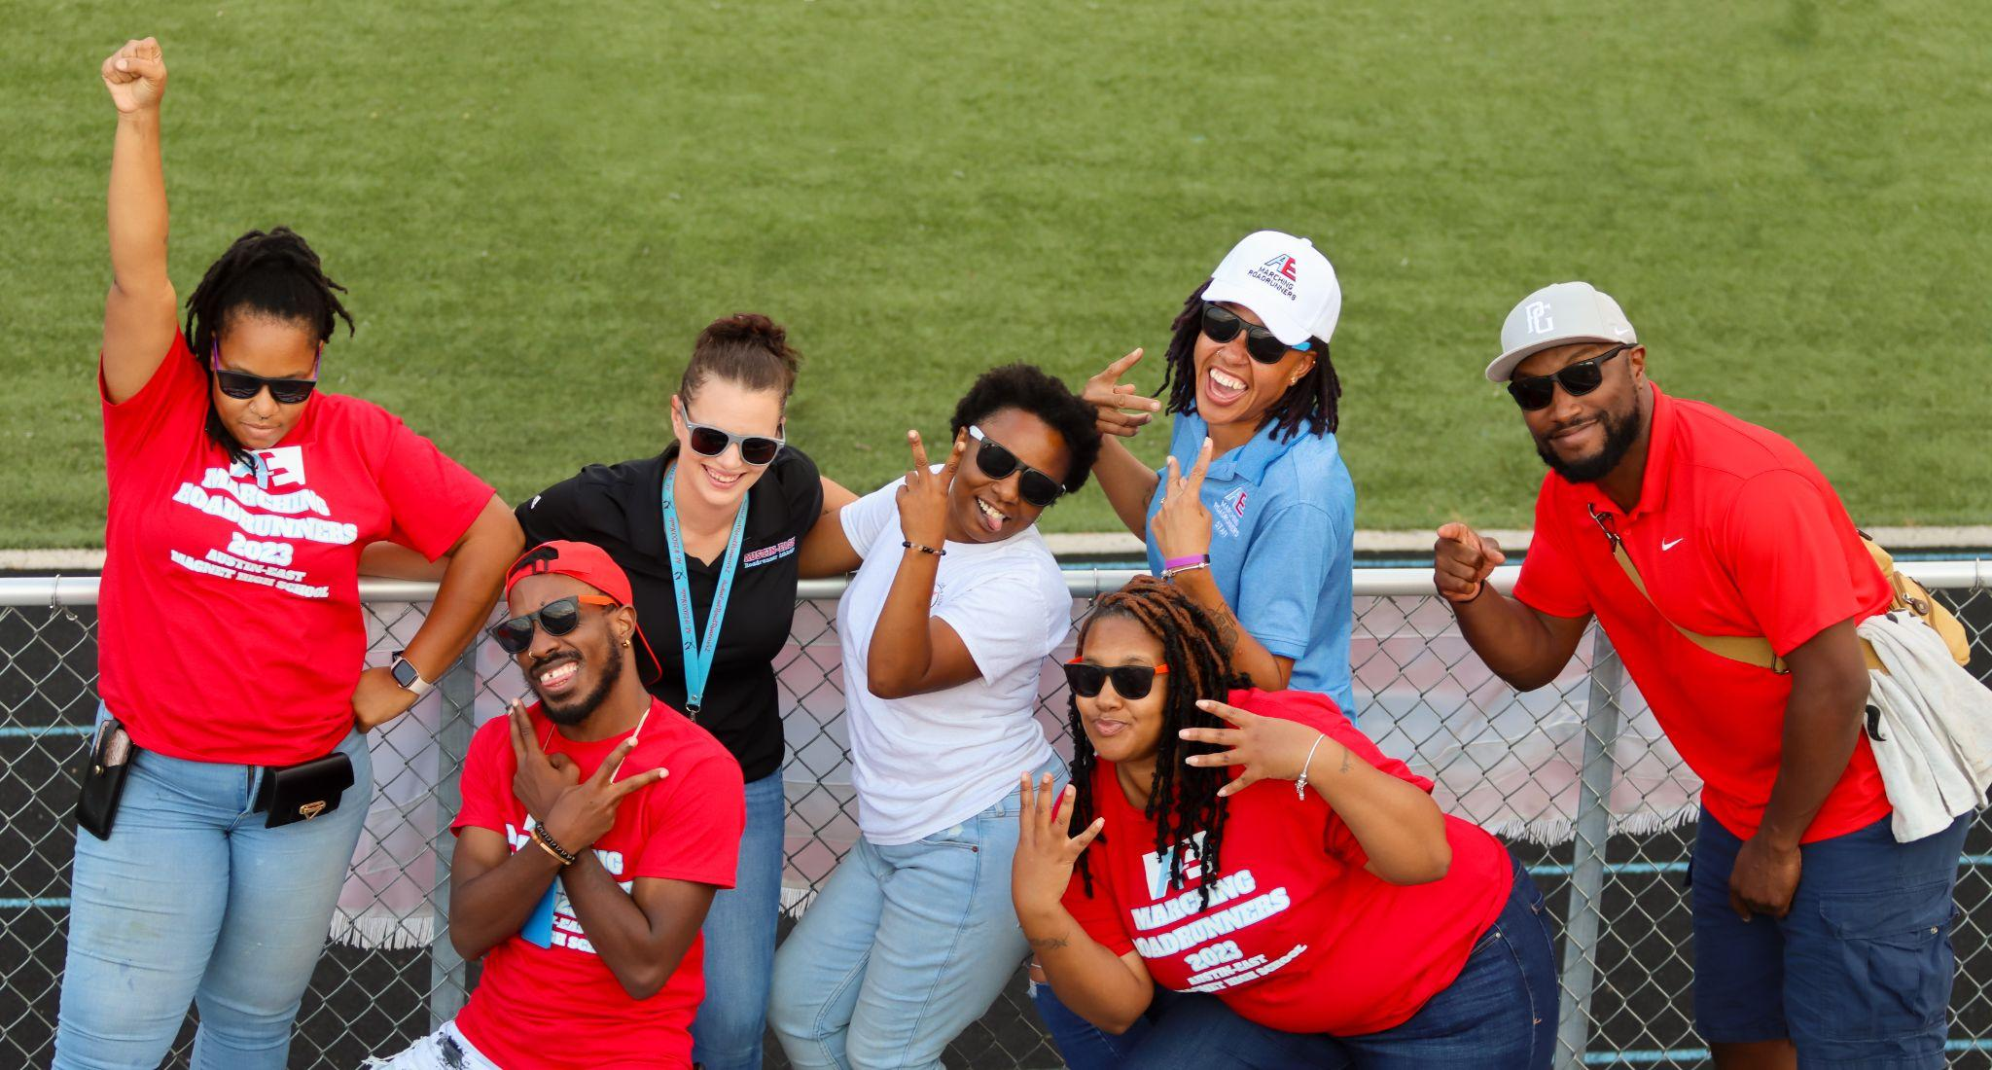
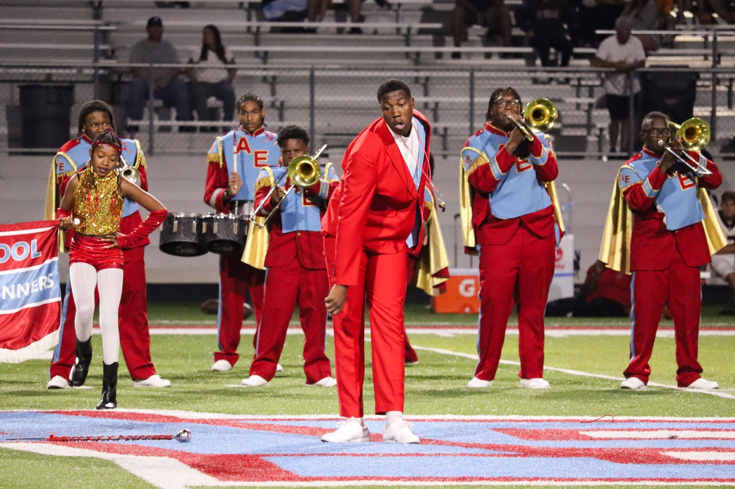
Band
Our band programs within Austin East ensure there is an opportunity for everyone to learn, play, and grow!
We currently offer:
Marching band (Fall), Jazz Band (Spring), Concert Band (Spring) and Basketball Band 2024 (Winter)

Slide 10
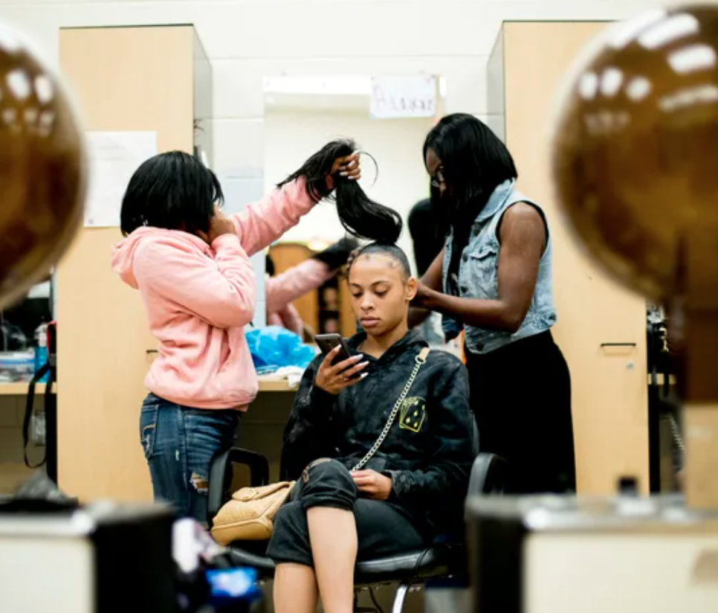
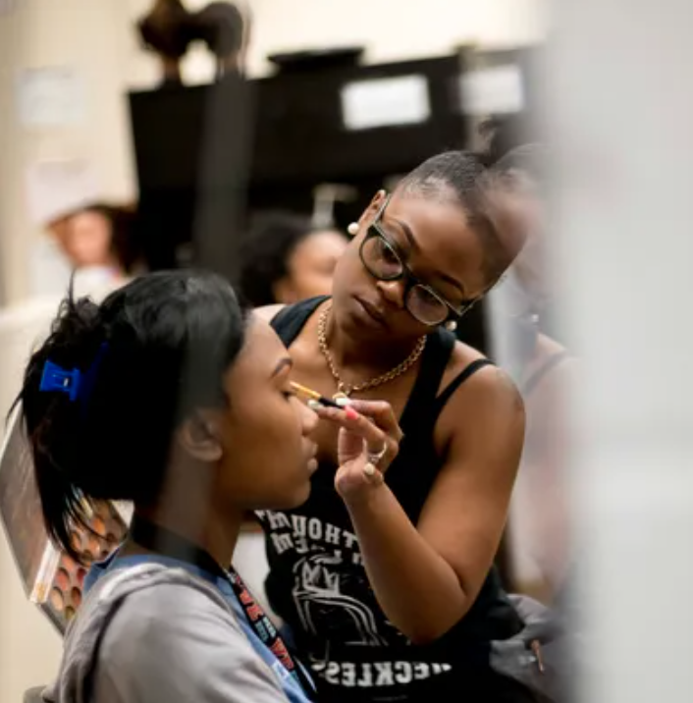
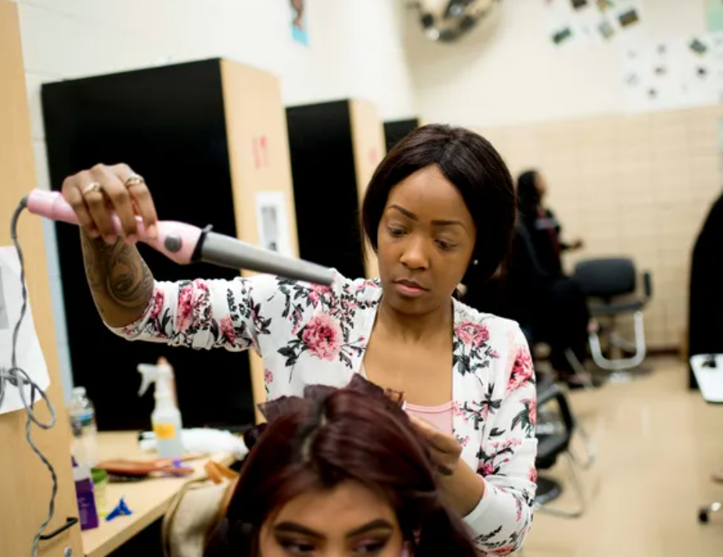
Cosmetology
The Cosmetology pathway immerses students in the art and science of beauty and wellness. Participants will acquire hands-on skills in hair care, skincare, and nail care, while also gaining a deep understanding of industry trends, customer relations, and business practices.

Slide 11
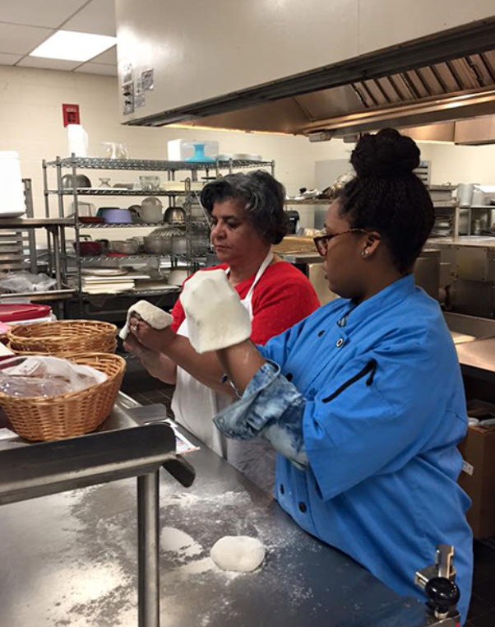
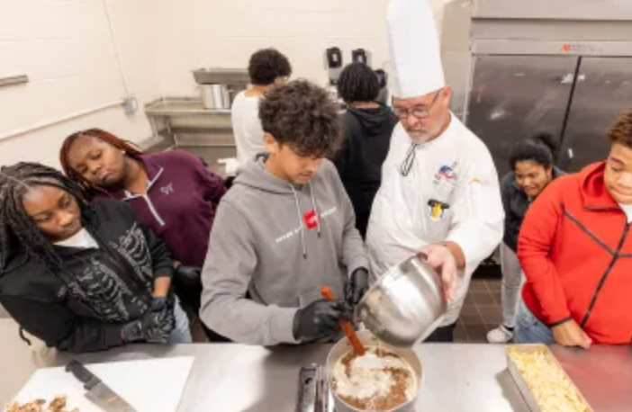
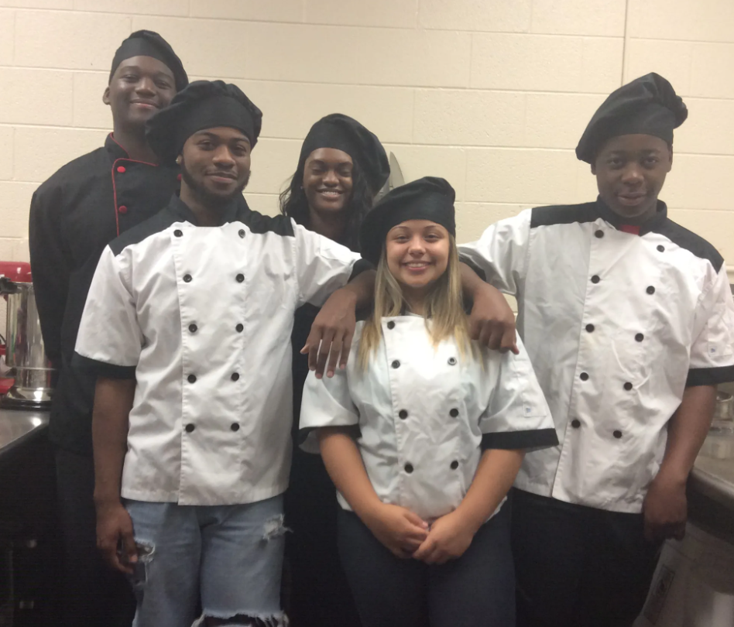
Culinary Arts
The Culinary Arts pathway is designed to equip students with the skills and knowledge necessary for working in or operating commercial kitchens by providing hands-on instruction emphasizing kitchen operation, safety, and sanitation as well as nutritional concepts and basic recipes.

Slide 12
Engineering
The Engineering pathway centers on the engineering design process, offering comprehensive instruction in engineering design, fundamental sketching, and engineering drawing techniques. Emphasis is placed on effectively communicating design solutions to others.

Slide 13
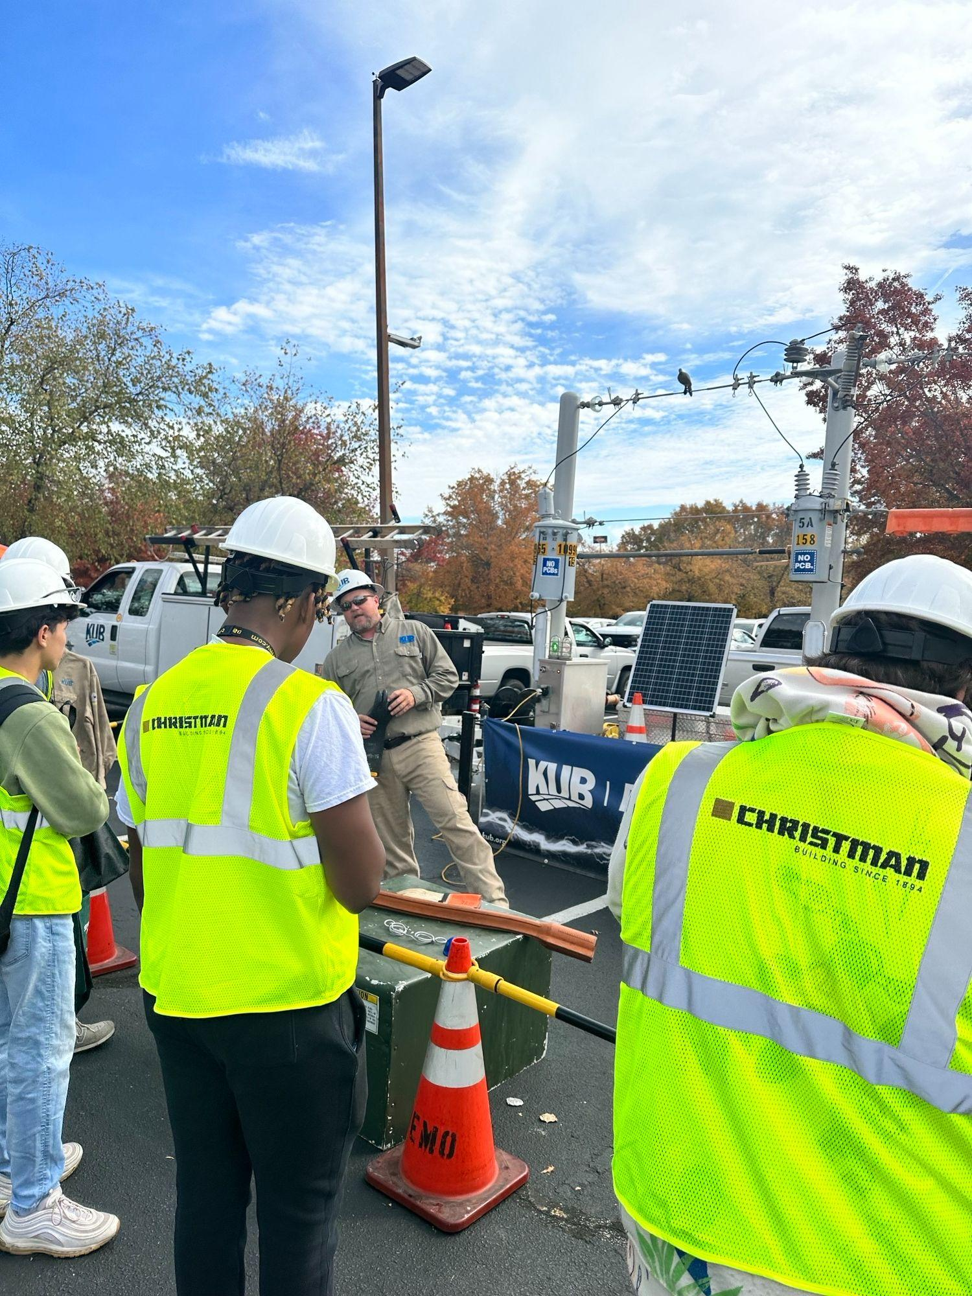
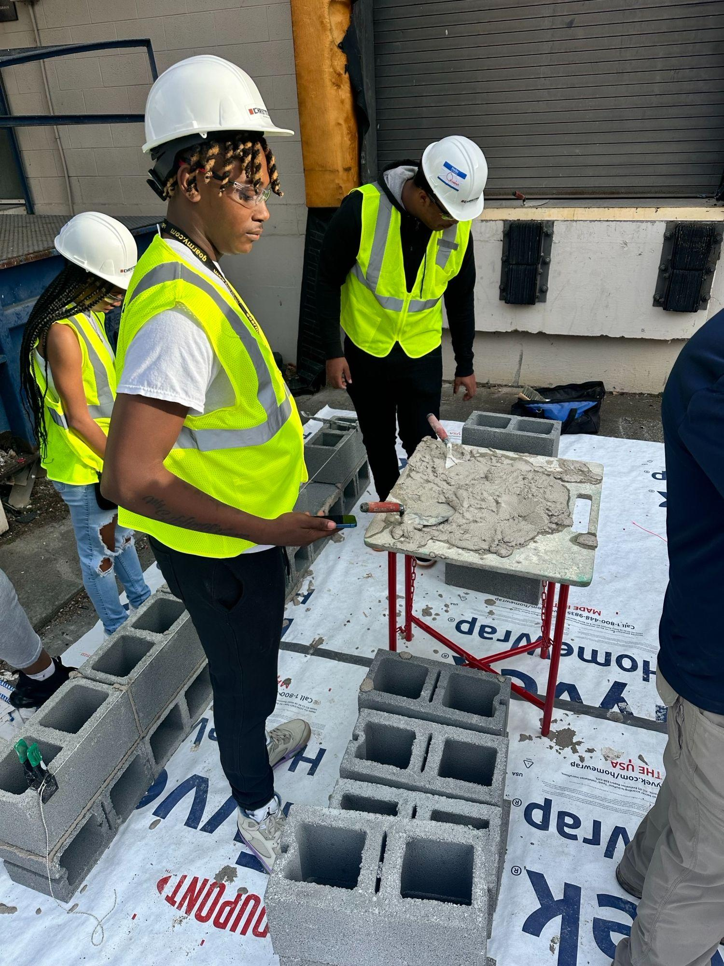
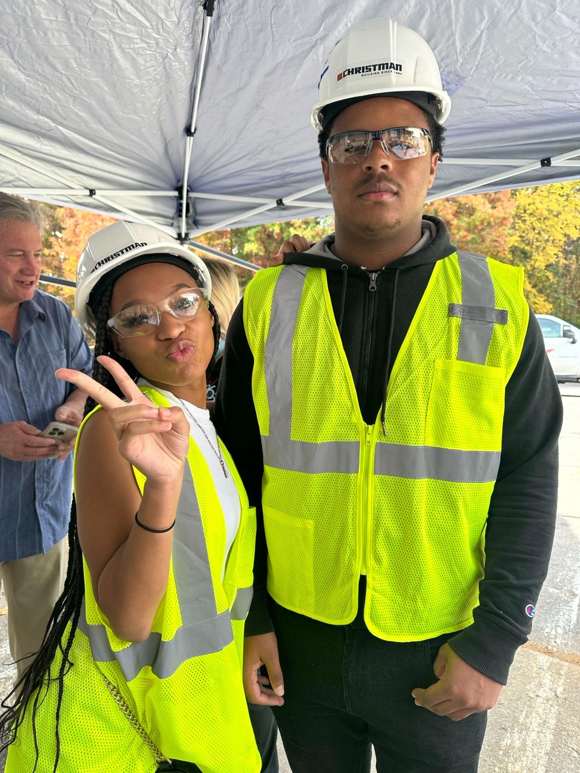
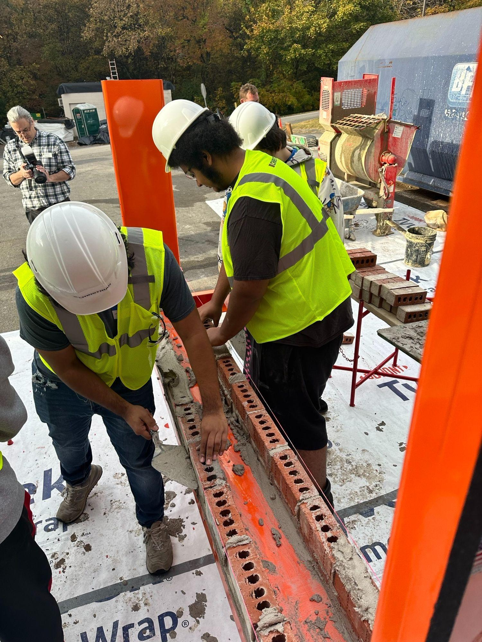
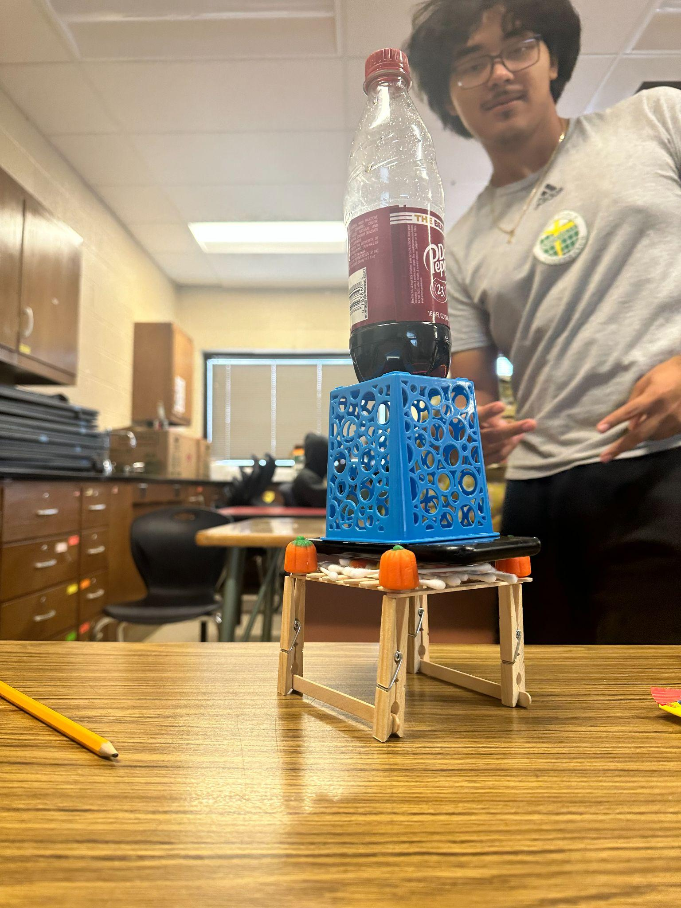
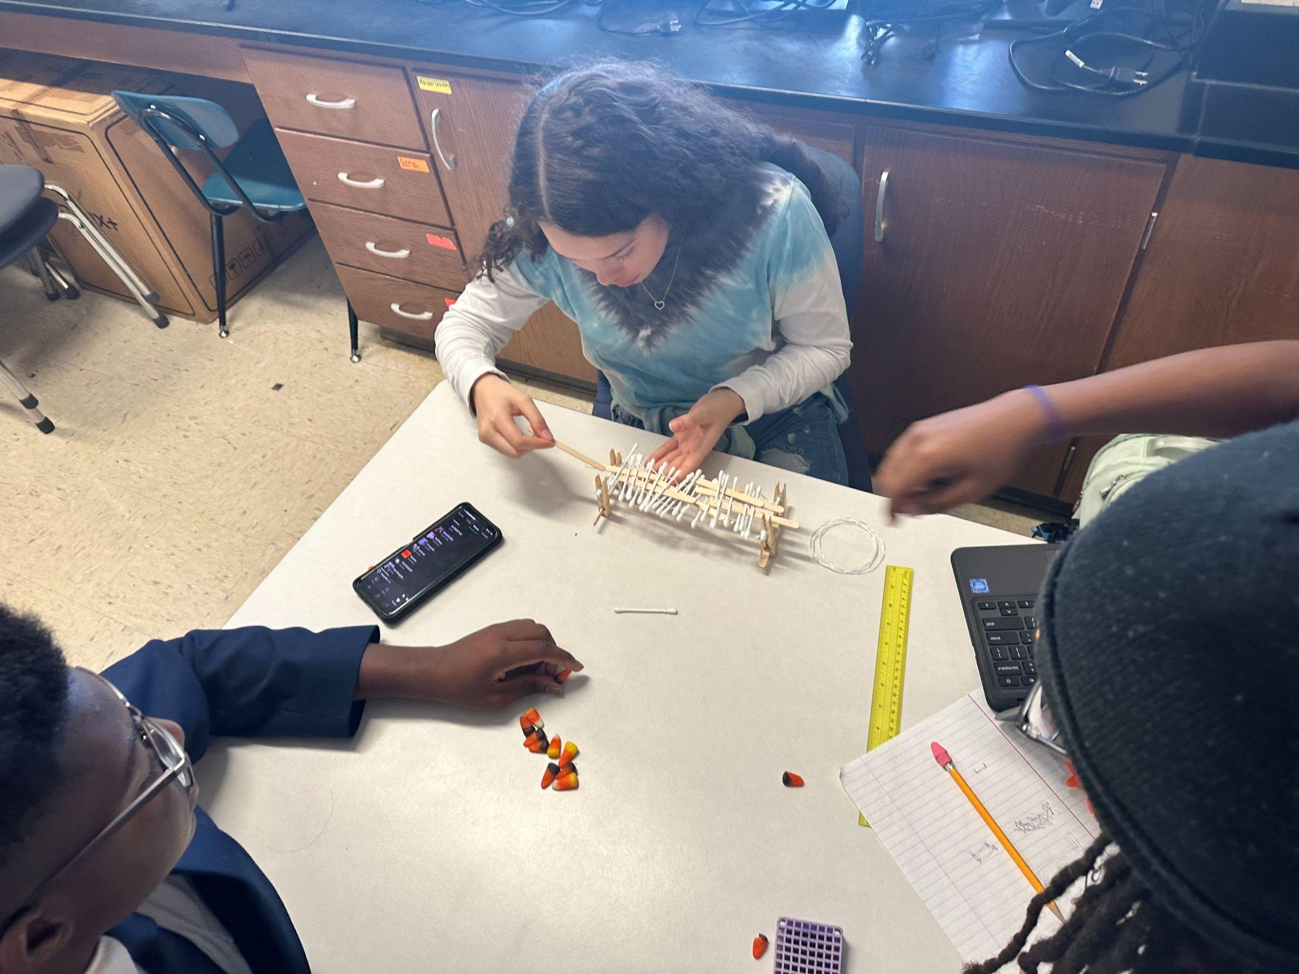
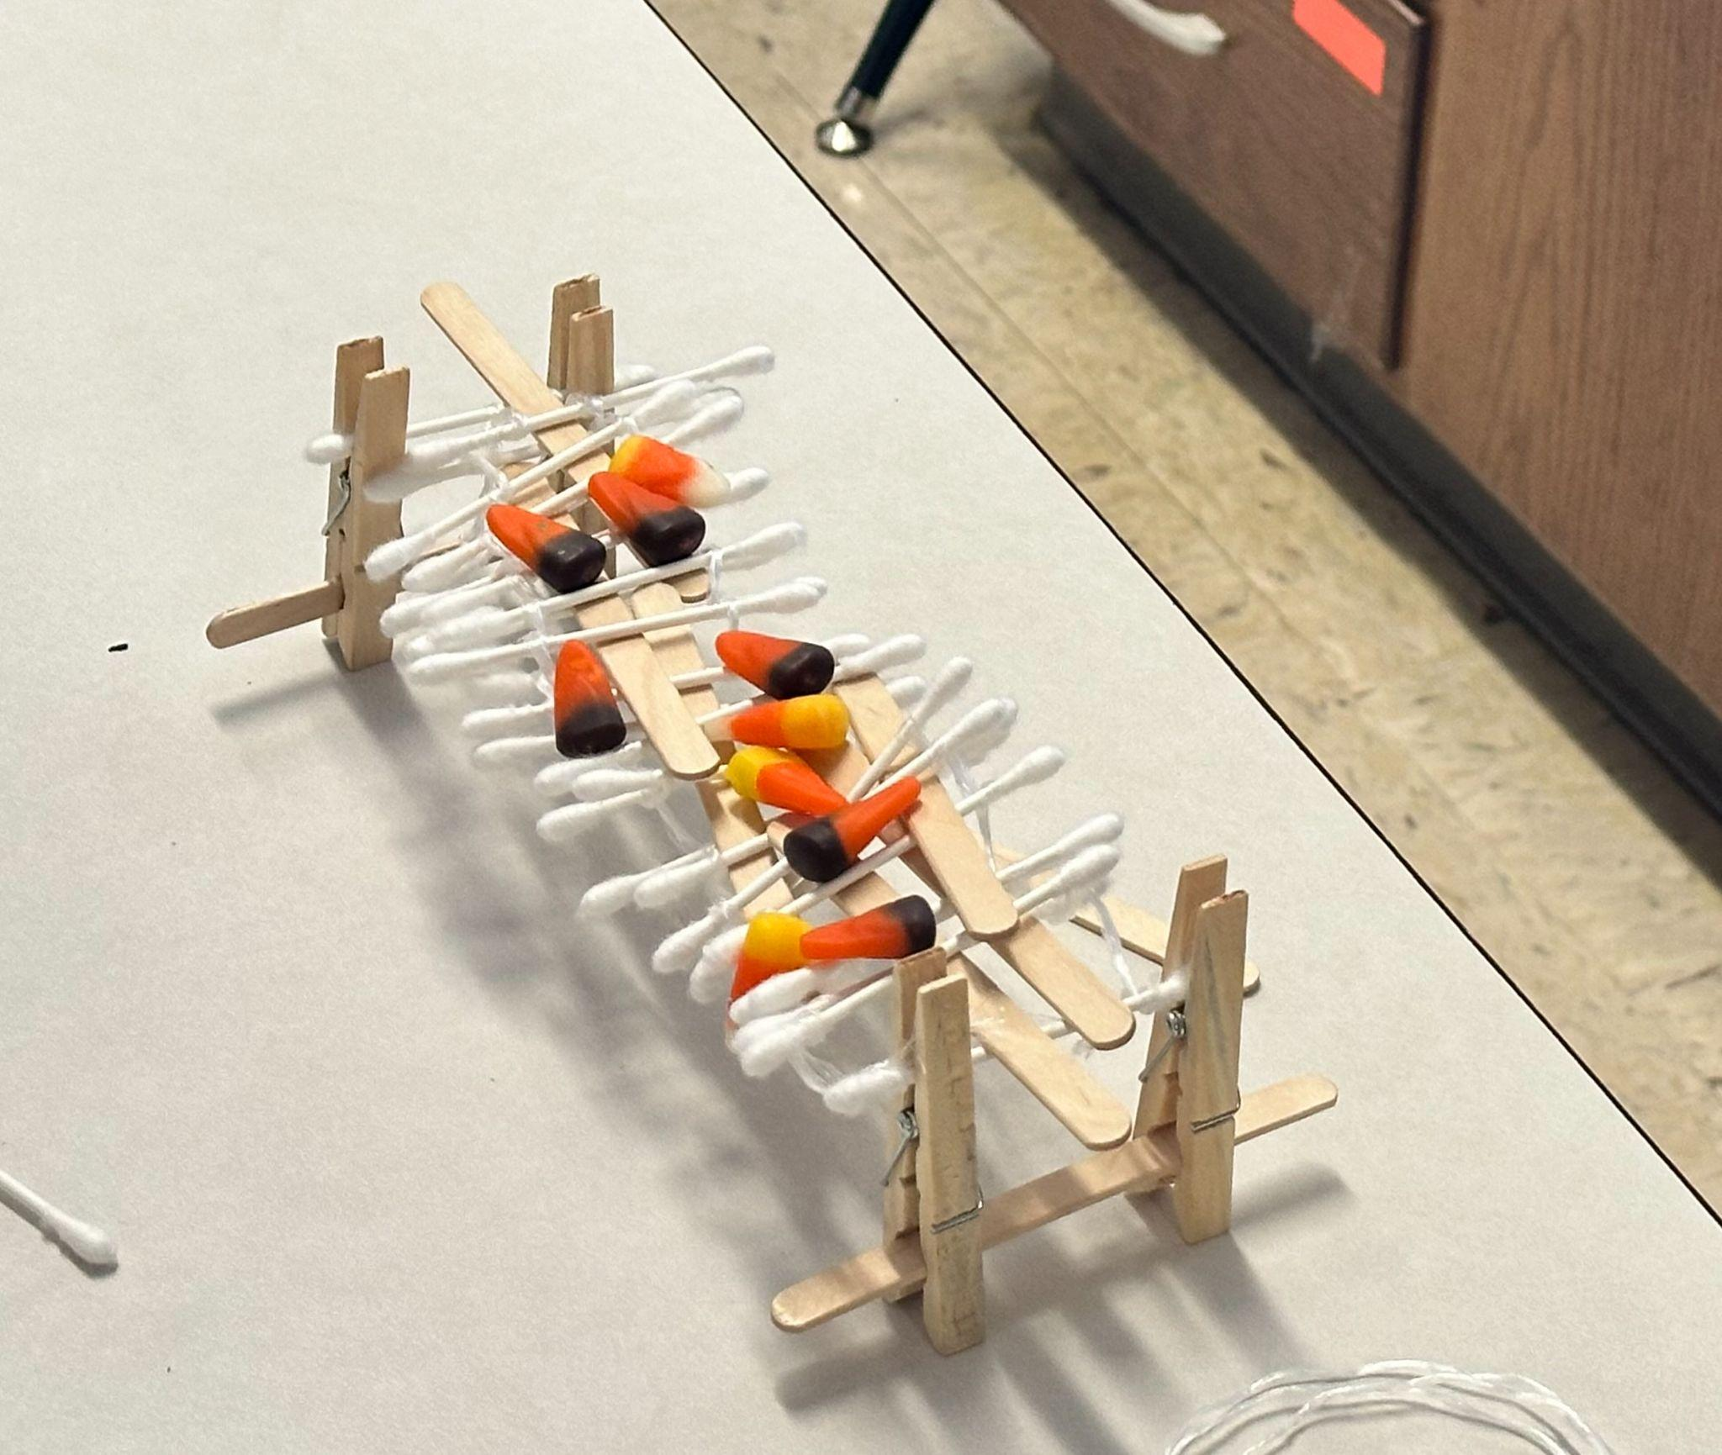
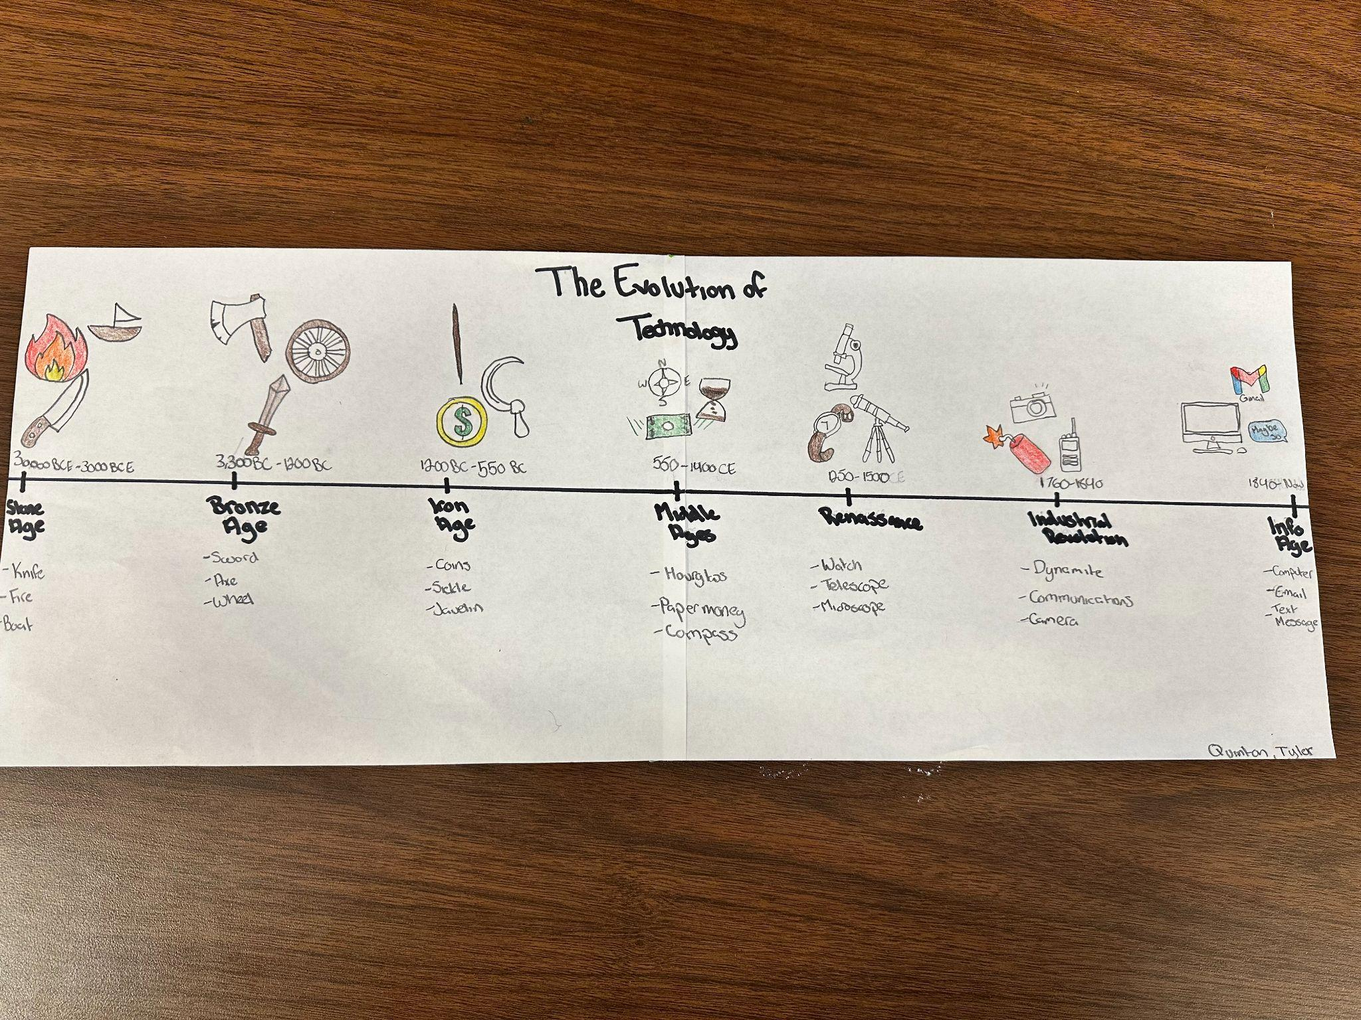
Engineering

Slide 14
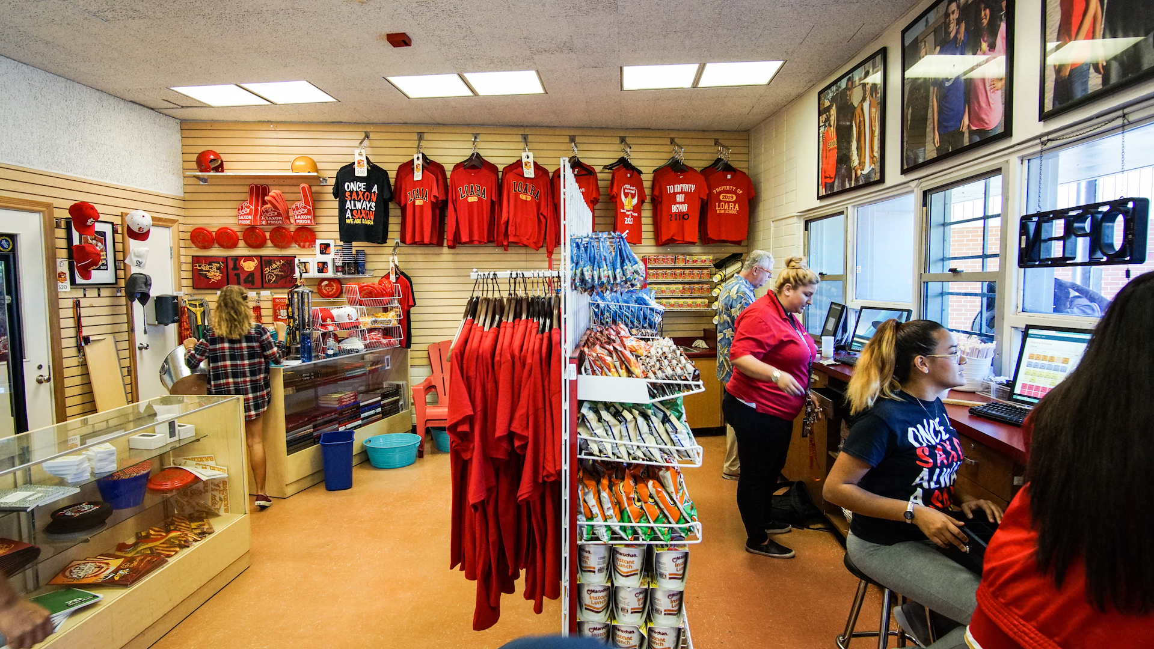
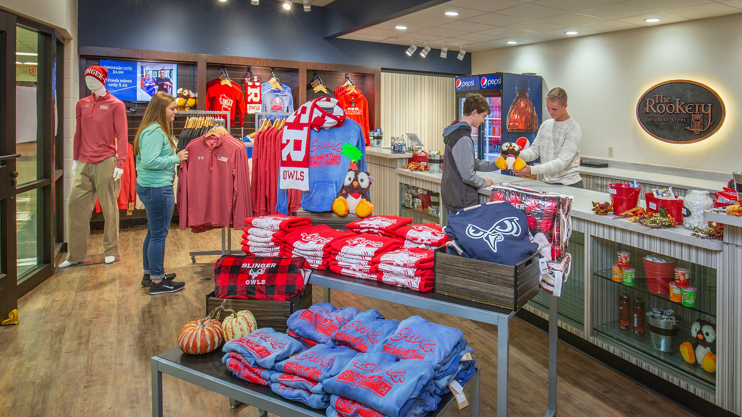
Entrepreneurship
The Entrepreneurship pathway empowers students to cultivate the skills necessary for conceiving, launching, and marketing original business ideas by providing knowledge and skills tailored to the startup environment and authentic business settings.

Slide 15
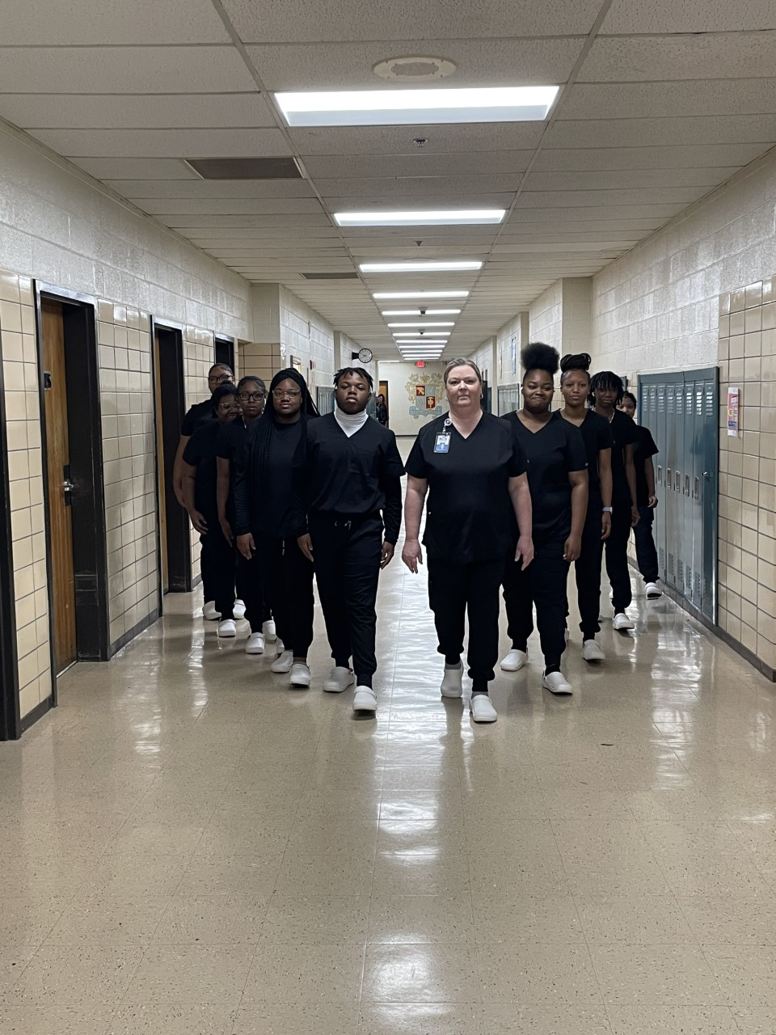
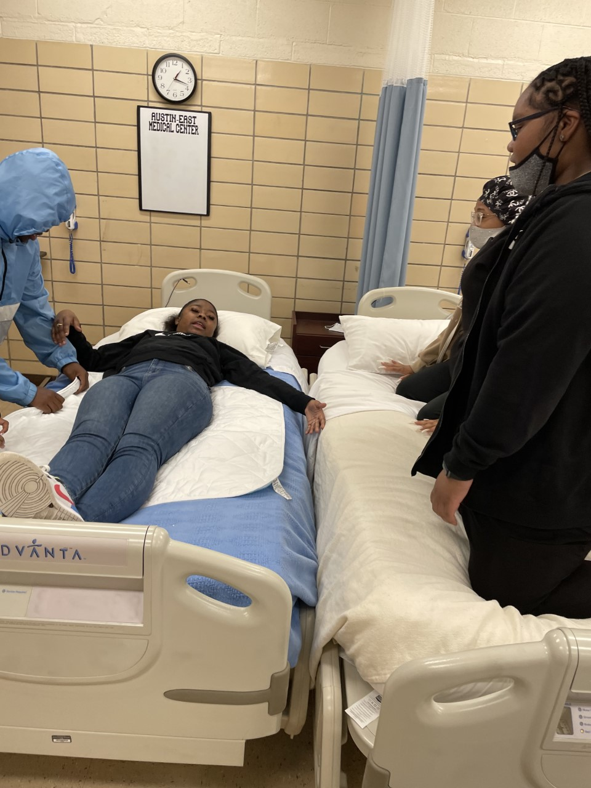
Health Science/Nursing
Health Science is a 4 course program (Health Science - Medical Therapeutics - Anatomy and Physiology - Nursing Education) leading to an opportunity to sit for the State CNA exam.

Slide 16
Theatre
The goal of the Theatre program at Austin-East Magnet High School is to give students an opportunity to learn every aspect of theatre which includes acting, writing, set design, lighting, costumes, stage management, and so much more!

Slide 17
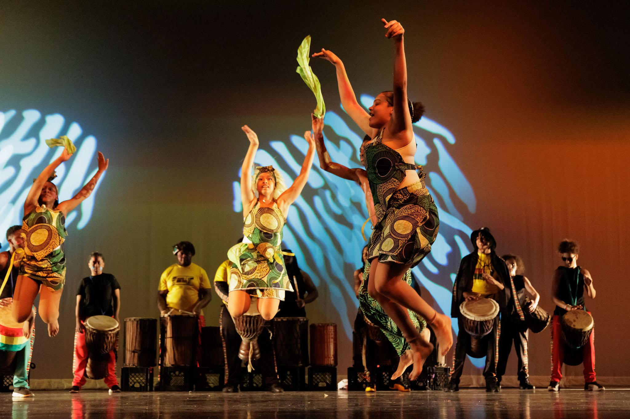
West African Dance
The West African drum and dance program has been a part of the performing arts department at Austin-East since the start of the magnet programs. The dancers learn traditional African dance techniques as well as the history and culture of the dances. If the dancers advance to the advanced classes, they have the opportunity to perform in various performances at AE and in the community.

Slide 18
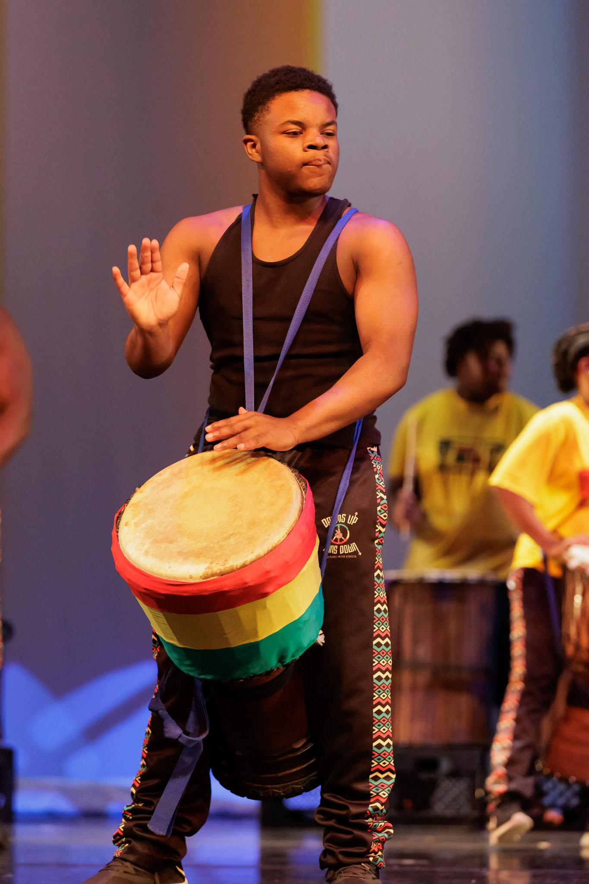
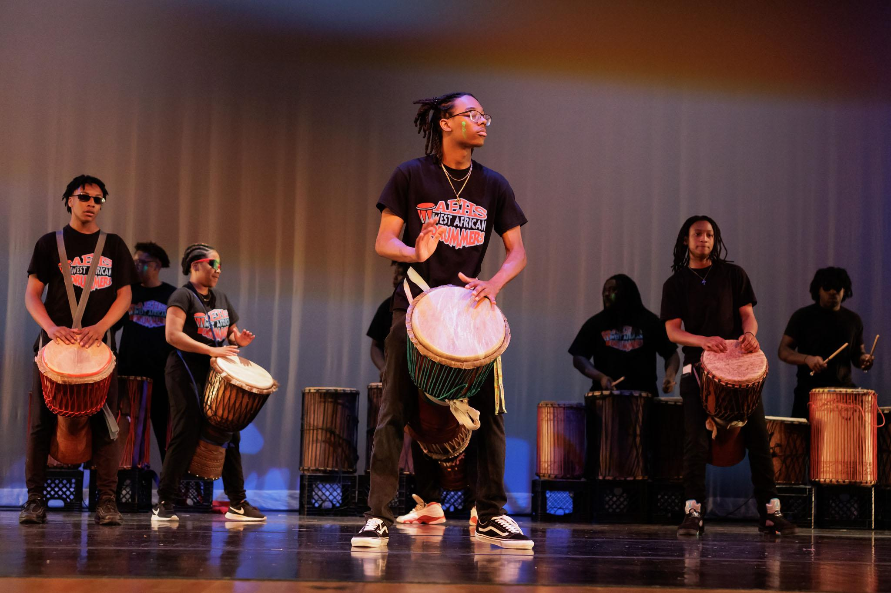
West African Drumming
The West African Drum program is a unique program only found at Austin-East Magnet High School. Obayana Ajanaku leads the program and teaches students in grades 9-12 in the traditional techniques of West African drumming and rhythms. Students who advance to the djembe accompaniment class perform for the Knox County Spring Dance Concert in the spring and other community performances throughout the semester.

Slide 19
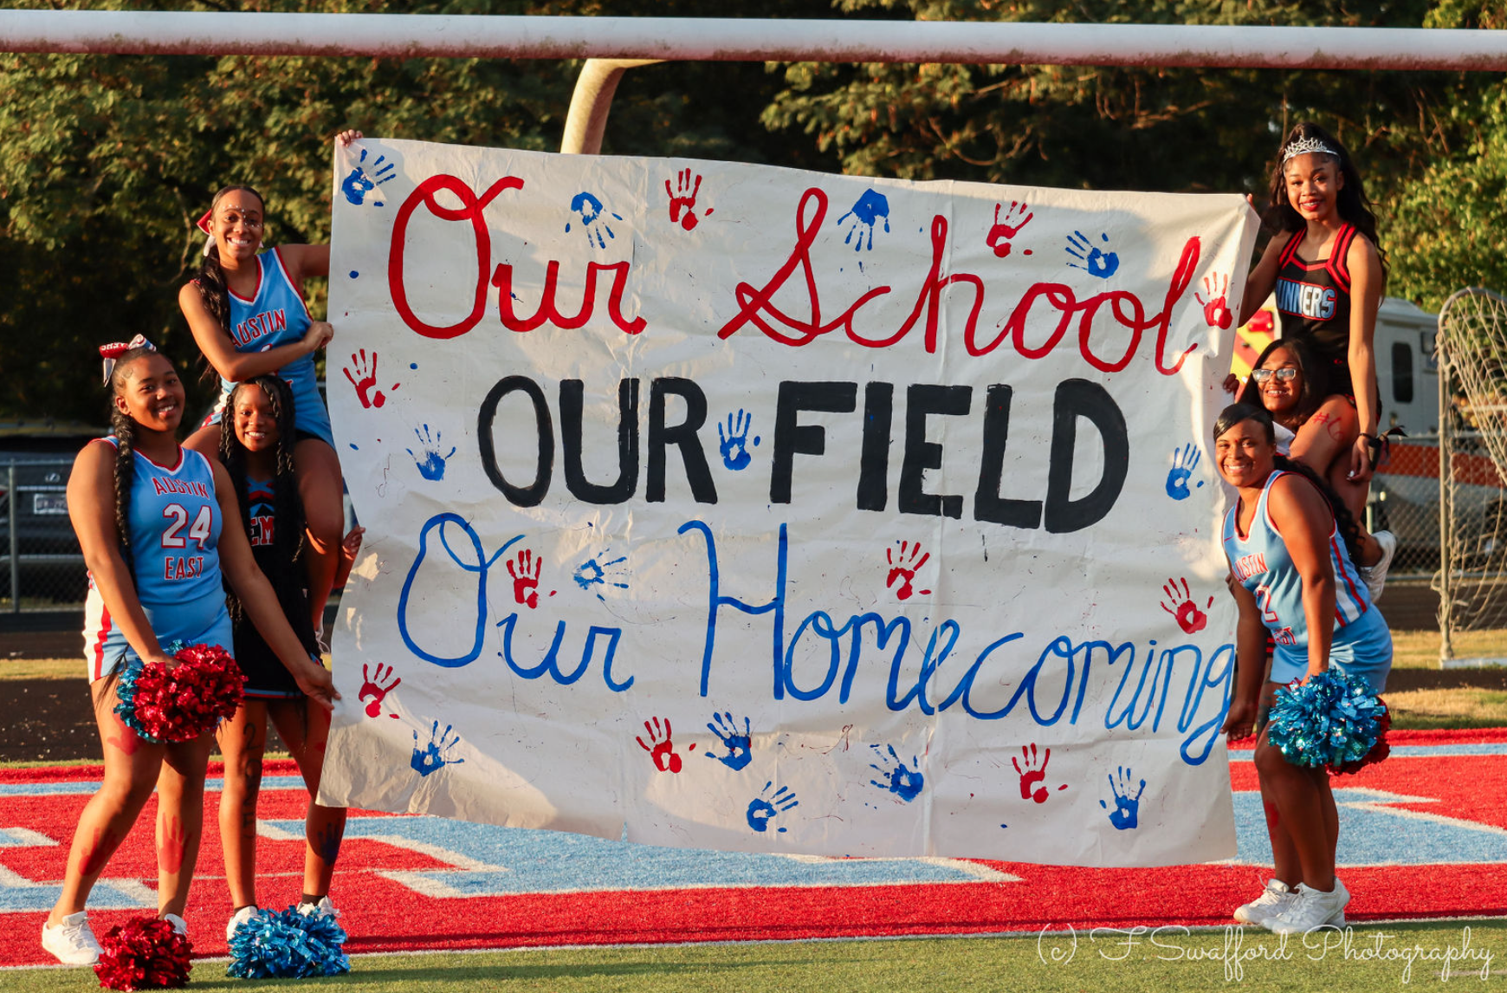
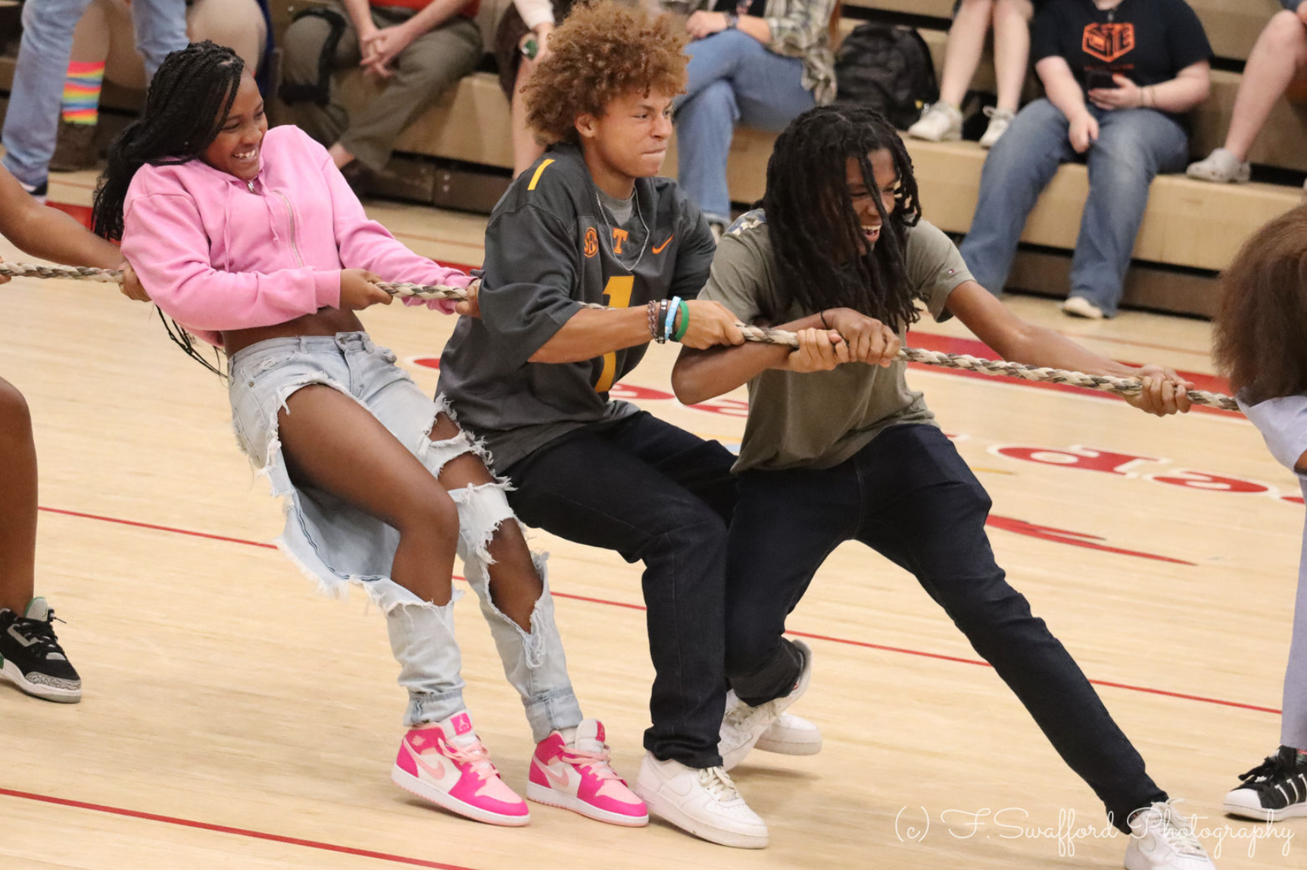
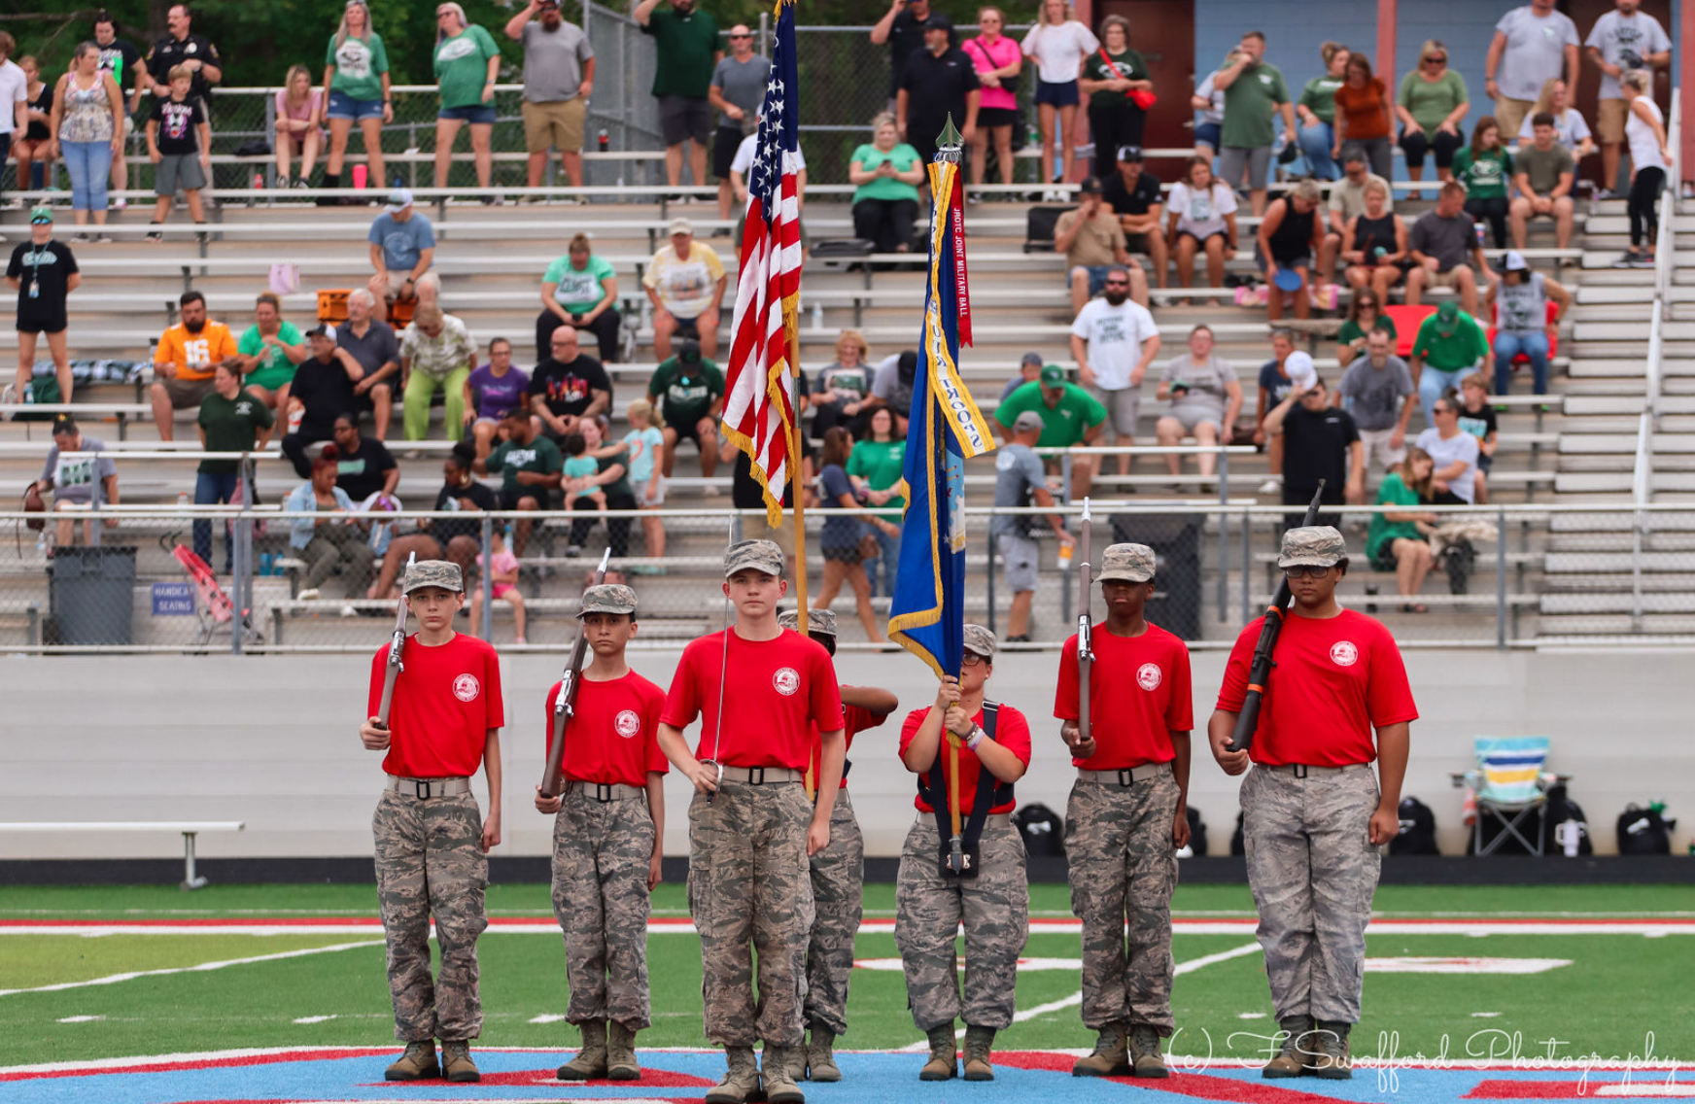
“One Stop Shop”
UT Flagship School
Project Grad
Trio
SMART Institute
Traditional Sports
Clubs & Organizations
All traditional academic courses and opportunities (honors, AP, dual enrollment)

Slide 20
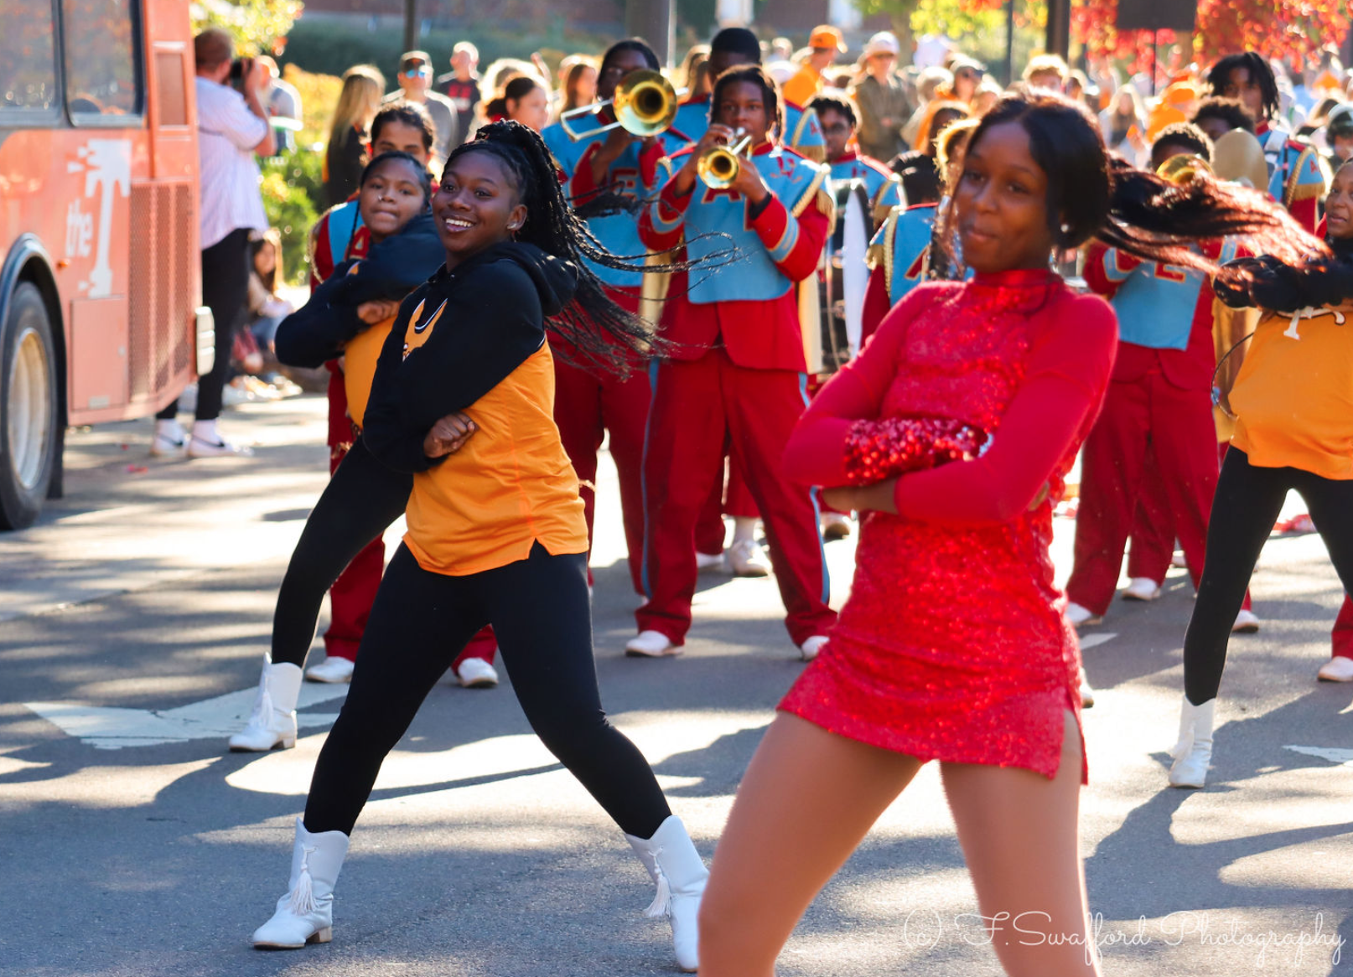
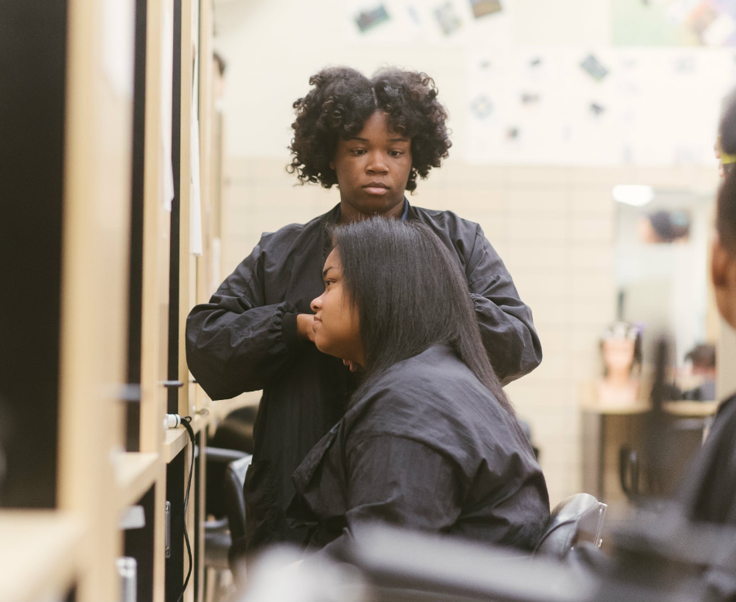
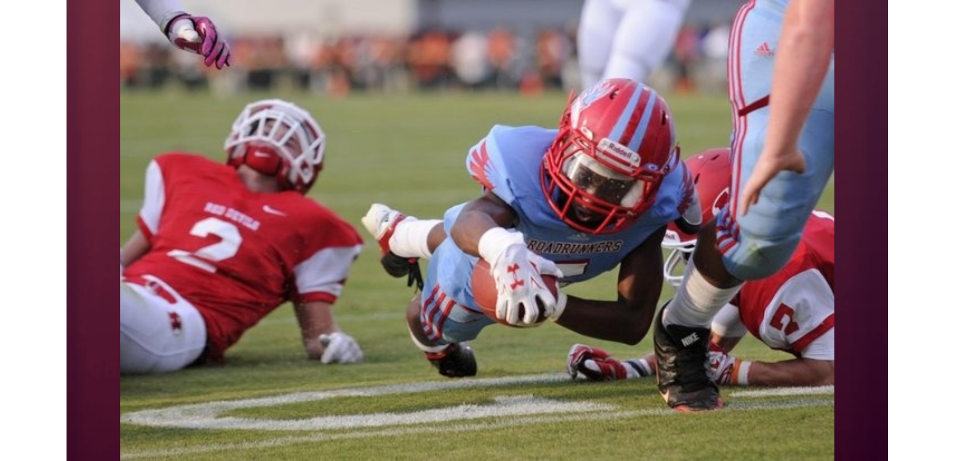
Let’s Connect!
What’s next?
Schedule a tour!
Schedule a shadow day!
Come to “Voices”, our next student choreographed performance in December!
Contact Information:
Sarah Edge or Tara Lowe
(865) 594-3792
@MsEdge_AE
sarah.edge@knoxschools.org
tara.lowe@knoxschools.org

